Slide 1
Timber in Construction Policy Roadmap
A brief overview of the Government’s plan to expand low-carbon timber construction.
David Hopkins
Director, Confederation of Timber Industries
CEO, Timber Development UK

Slide 2
Background
The Government has committed to expanding timber construction in the Net Zero Strategy and England Trees Action Plan.
Timber recognised as essential to net zero by the Environmental Audit Committee and Climate Change Committee.
The Government created the Timber in Construction Working Group (TiCWG) to outline a roadmap for timber expansion.
Presented By : David Hopkins
Notes:
The Government has recognised timber as essential to its net zero plans in the Net Zero Strategy and ETAP.
This comes following reccomendations by important government bodies such as the EAC and CCC
The working group is an effort to put these reccomendations into action.

Slide 3
WORKING GROUP THEMES
Demand
Supply
TiC ROADMAP
Building Safety
Insurance
Carbon
Skills
Notes:
Industry and government have identified six key themes where barriers exist to expanding timber construction.
Stakeholders:
TDUK, STA, Confor, NMITE, builders, architects etc...
Gov:
DEFRA, DLUHC, DESNZ, FC

Slide 4
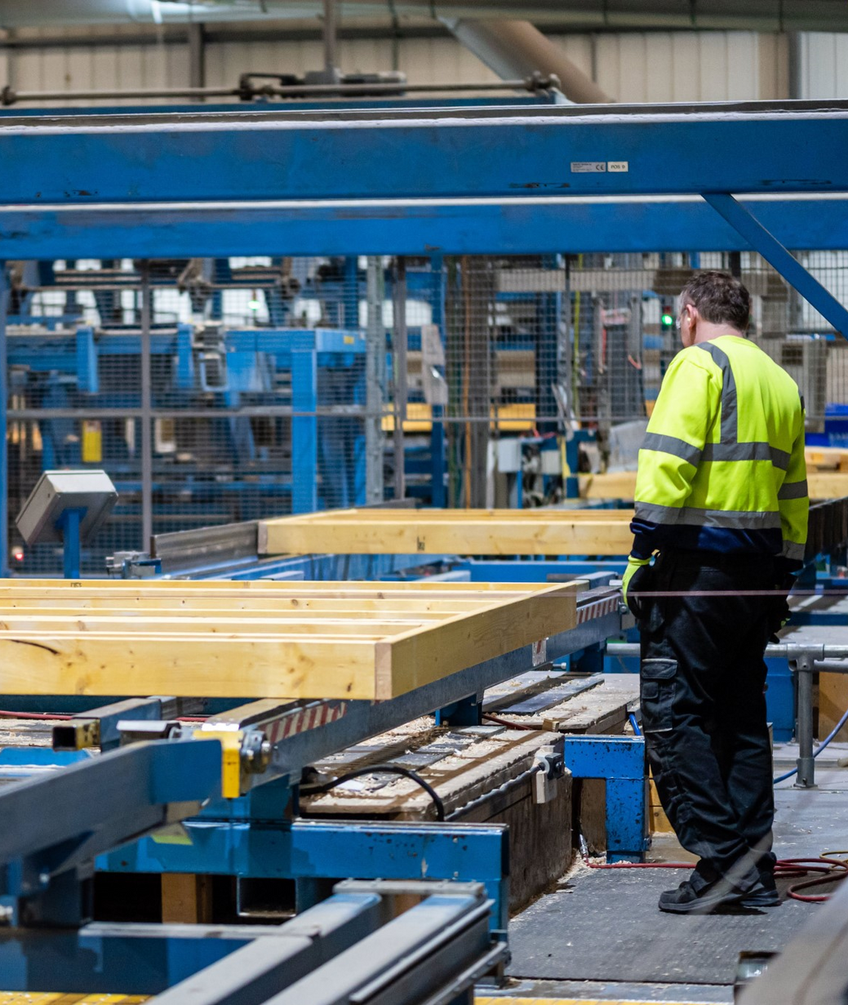
DEMAND
Looking at ways to promote timber as a low-carbon building material and increase timber systems in construction.
We have called for:
Low-carbon public procurement
Low-carbon MMC housing delivery
Limits on embodied carbon in construction
Notes:
Timber frame use in England is low, standing at 9%.
The TiCWG is looking at ways to increase demand for timber.
Why is demand low?
- Price misconceptions
- Misplaced safety concerns
- Low confidence
Can boost demand through:
- Public procurement
- Low-carbon MMC
- Embodied carbon limits

Slide 5
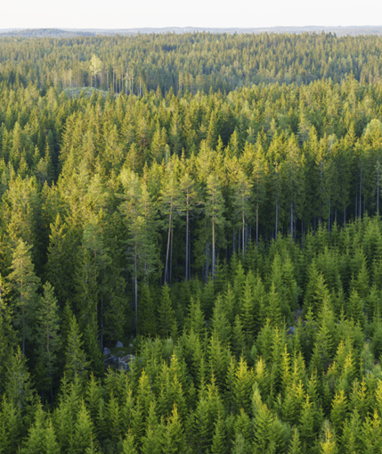
SUPPLY
Looking at ways to increase the sustainable supply of timber, both from the UK and abroad.
We have called for:
Streamline planning process for woodland creation
Productive forestry targets for DEFRA
Further collaboration with international partners on forest governance/management
Notes:
Increasing timber supply is essential, with demand for wood products set to quadruple by 2050 (World Bank).
UK is worlds second largest importer of timber - this is not a bad thing.
To match growing demand, we need to grow more productive woodland in the UK to COMPLEMENT NOT REPLACE imported timber.

Slide 6
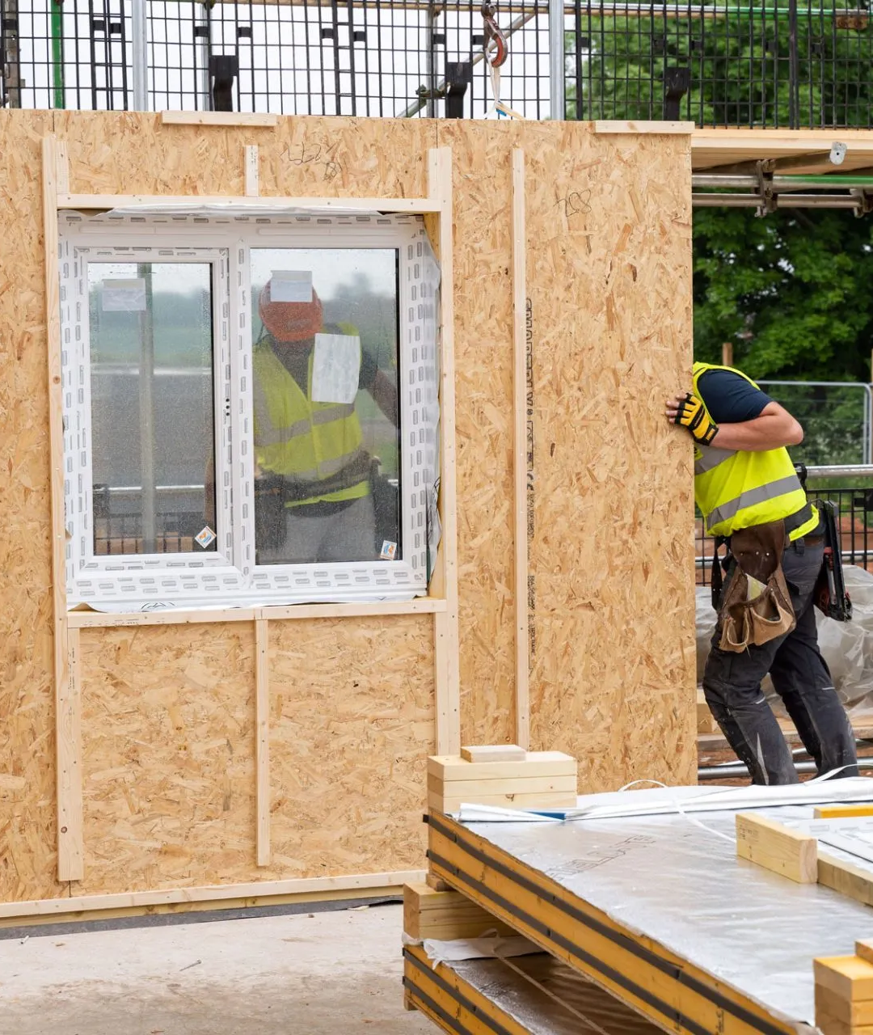
BUILDING SAFETY/INSURANCE
Looking at ways to address concerns about fire safety and durability, whilst also fostering collaboration between industry and insurers.
We have called for:
Government to promote timber as a safe building material
Government to foster dialogue between industry and insurance
Government to take systems-led, not material-led approach
Notes:
Building safety a key barrier to expanding timber construction.
Since Grenfell, there has been increased anxiety about combustible materials e.g., GLA combustible materials ban.
Building safety and insurance more of an issue for mass timber sector which is high/medium rise.

Slide 7
CARBON
Looking to help improve embodied carbon reporting and explore embodied carbon limits.
We have called for:
The introduction of Whole Life Carbon Assessments (WLCAs) into building regulations
Government should adopt CLC’s National Retrofit Strategy
Notes:
A key driver for the increased use of timber in construction in England are the efforts to reduce the embodied carbon in the built environment.
Carbon stimulates timber demand.
Limits on embodied carbon seen in France, Denmark, Netherlands etc.
UK looking to open consultation on this - likely next year.

Slide 8
SKILLS
Looking to increase skills, capacity and competency across the timber supply chain.
We have called for:
Scaling up DT classes in schools
Incentives to create more timber construction courses
Reform of the Apprenticeship Levy to include short courses
Notes:
Skills shortages are a key issue for timber but also construction as a whole.
More practical skills needed in the economy. Also more timber courses and apprenticeships at higher education and university level.

Slide 9
INDUSTRY PROGRESS
DEMAND
SUPPLY
BUILDING SAFETY
CARBON
SKILLS
Industry campaigns
Technical publications
Highlighting best practice e.g. Wood Awards
Responsible Purchasing Policy
Statistical analysis
Timber Typologies Book
Fire safety website
STA Assure scheme
Counting carbon paper
Timber Industry Net Zero Roadmap
EPD library
NMITE’s Timber TED courses
TDUK University Design Challenge
Competency framework

Slide 10
TiCWG TIMELINE
1. Industry sub-groups
August - March 2022/3
There has been significant collaboration across industry and throughout the timber supply chain to understand what barriers exist, and what solutions are available to address them
3. Finalising the roadmap
October 2023
The roadmap is awaiting approval from Michael Gove and Therese Coffey.
4. Publication
November 2023
The roadmap is set to be published in November this year, where it will be launched at the APPG for the Timber Industries Autumn Luncheon in the House of Commons
2. Industry and government workshops
December - July 2023
The CTI along with other trade associations, academics and industry partners have held several policy workshops with representatives from DEFRA, DLUHC and Forestry Commission
Notes:
The TiCWG has been in the pipeline for some time.
The CTI has been active in several sub-groups and workshops, outlining what the barriers are to timber construction and how we solve them.
The roadmap has been signed off by Forestry Minister, Trudy Harrison. We are expecting publication in mid November.

Slide 11
OUR LATEST REPORT
DEMAND
INCREASING THE UK'S LOW-CARBON
MANUFACTURING CAPACITY
SUPPLY
STRENGTHENING THE RESILIENCE
OF OUR TIMBER SUPPLY
BUILDING SAFETY
DEMYSTIFYING THE USE OF
TIMBER IN CONSTRUCTION
LABOUR AND SKILLS
GROWING SKILLS AND JOBS IN
THE LOW-CARBON ECONOMY
Notes:
You can read all of our roadmap policy recommendations in our latest APPG report - Timber Construction: Barriers and Solutions
We have brought some copies here today, however this is also available via the CTI website and social media.

Slide 12
Keep up to date
020 7291 5377
LinkedIn: Confederation of Timber Industries
Twitter: @CTI_timber
www.cti-timber.org
The Building Centre, 26 Store Stree, WC1E 7BT
Notes:
We expect the roadmap to be released next month.
We encourage you to follow us on LinkedIn and X (twitter) to keep up to date.

