Slide 1
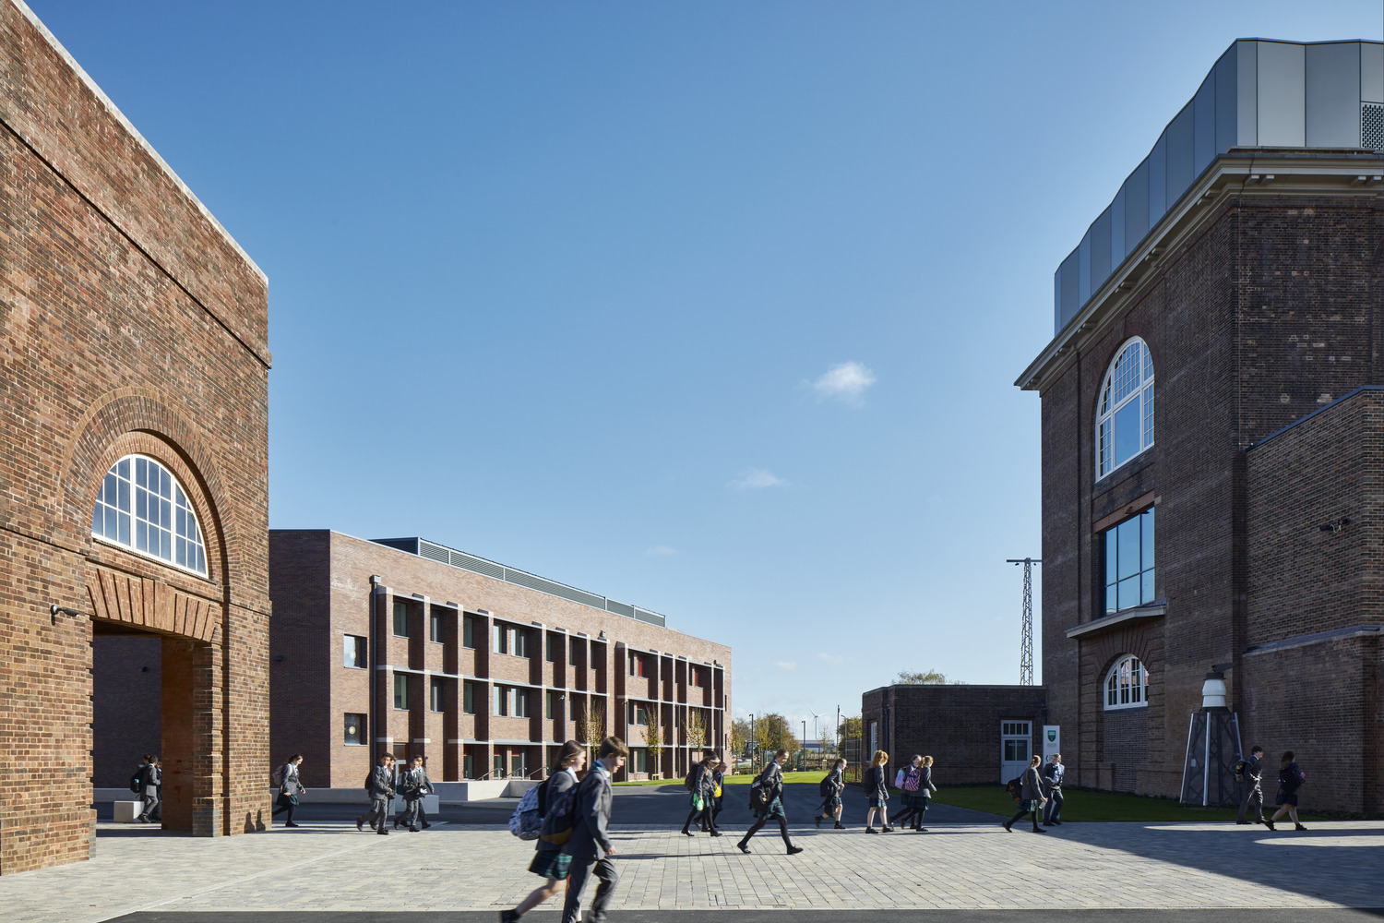
Is repurposing buildings the silver bullet solution
to the environmental crisis?
Repurpose

Slide 2
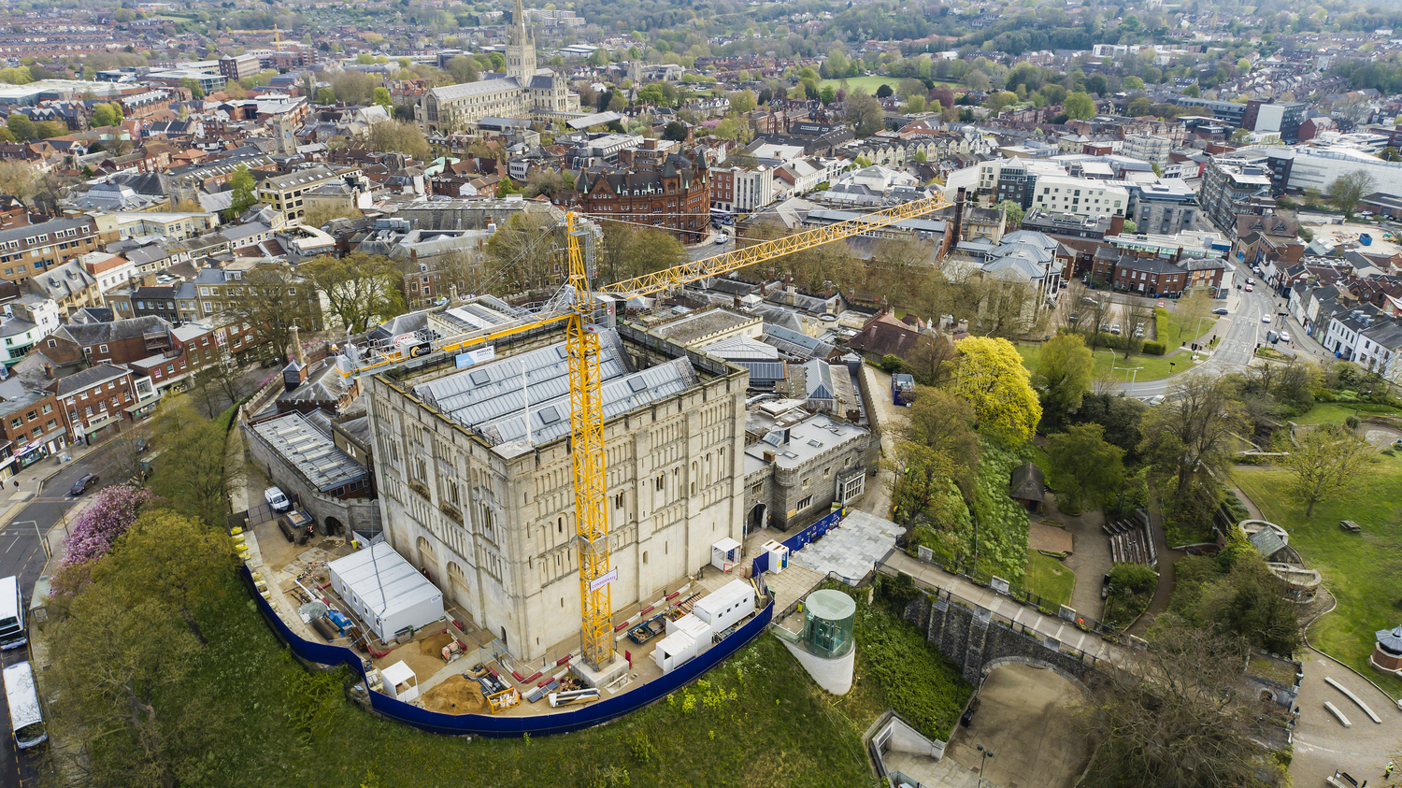
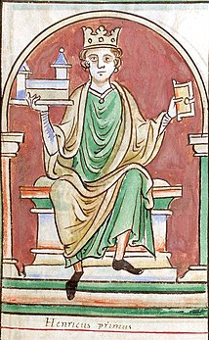
Repurposing
buildings
is not new

Slide 3
WHAT IS DRIVING TODAY’S DESIRE TO REPURPOSE BUILDINGS?
The Environment
Online Shopping
Covid Pandemic

Slide 4
FOUR PILLARS – REPURPOSING BUILDINGS
CARBON
4 PILLARS
COST
ECONOMIC
SENSE OF PLACE

Slide 5
CHALLENGES – REPURPOSING bUILDIDNGS
Structural
limitations
Functional
constraints
Maintenance
& upkeep
Loss of design freedom
Modern infrastructure
Load bearing, outdated, inadequate,
unsafe
Lack of alignment with needs – standards or aesthetics
Age = more wear and tear. Historic may require specialised preservation
No blank sheet of paper, only a list of boundaries!
In a new build, designing for M&E is much easier in a new build, than a retrofit

Slide 6
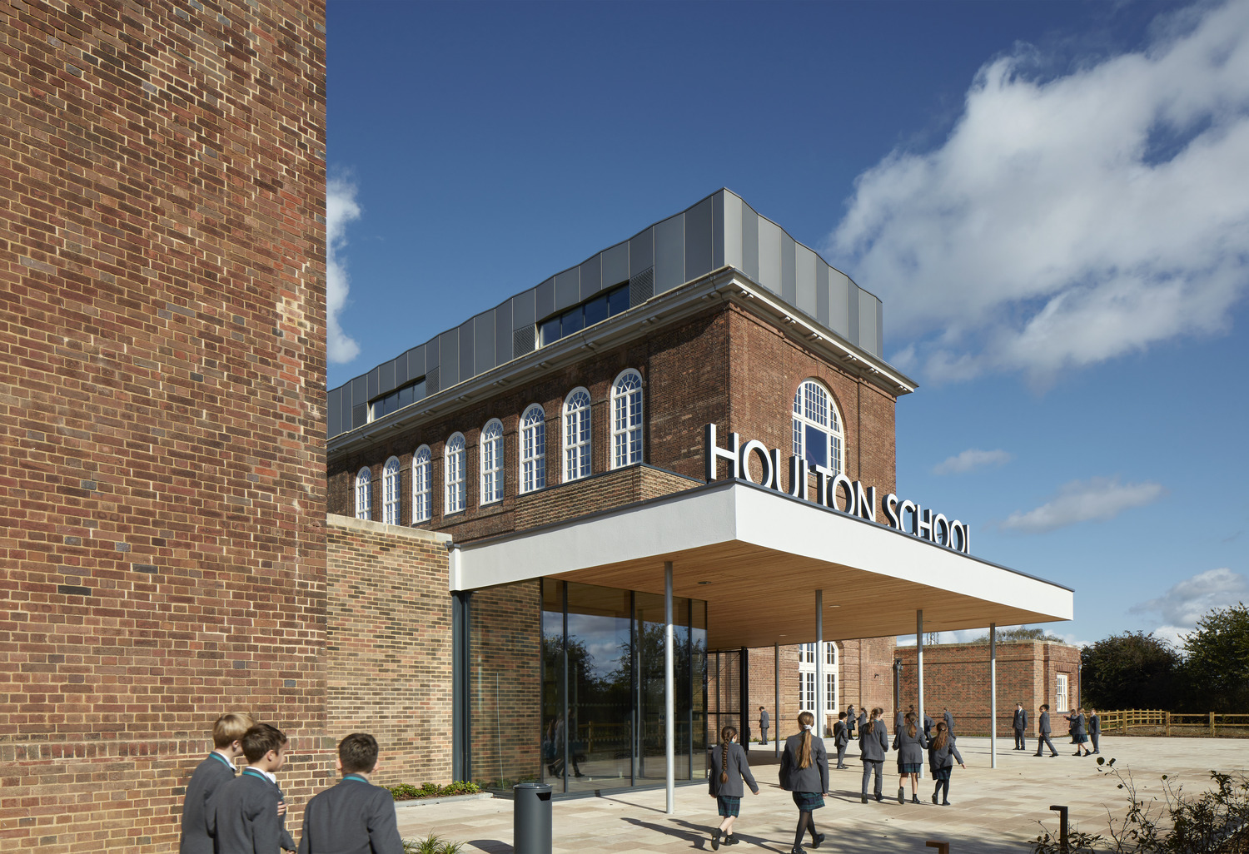
Houlton School
Respecting the past, whilst reaching to the future

Slide 7
History and scope

Slide 8
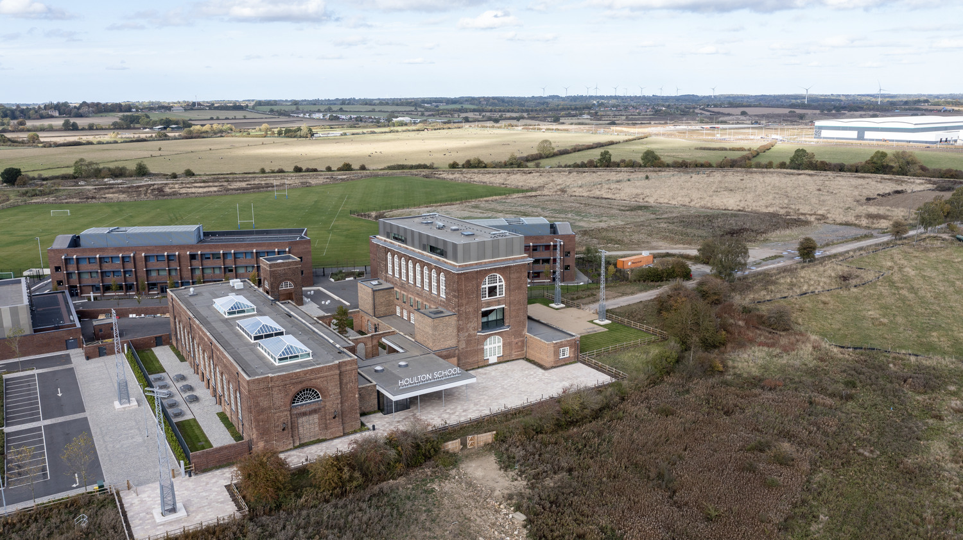
Challenges and
considerations
Repurposing the building
Planning permission
Grade II listed Building – poor energy performance
Funding
Structural integrity
Safety
Contamination
Balancing modern needs with heritage preservation
Specialist supply chain needed
DfE compliant
Value engineering

Slide 9
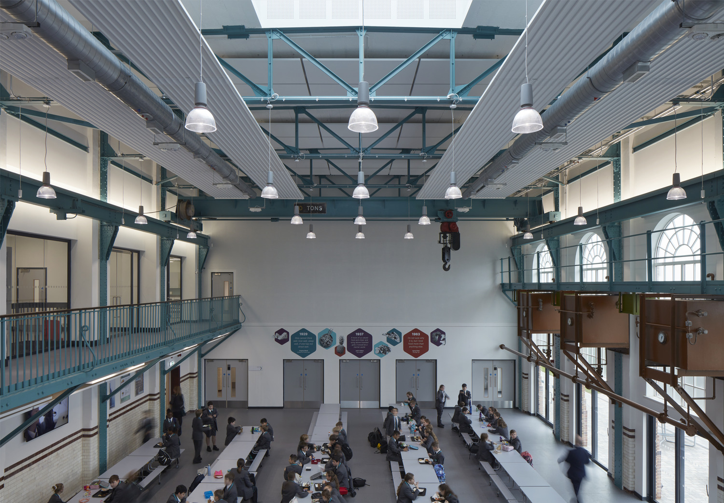
Overcoming the
challenges

Slide 10
HOW DID hOULTON HIT THE FOUR PILLARS?
CARBON
4 PILLARS
Carbon Outcomes
COST
Cost Outcomes
ECONOMIC
An attractive new community Grade II Listed Building
SENSE OF PLACE
“It speaks of quality the moment you walk through the door. Parents have said it’s like coming to an independent school without the fees. We are incredibly fortunate, all of our facilities are fantastic and state-of-the-art.” Michael McCully, Principal, Houlton School

Slide 11
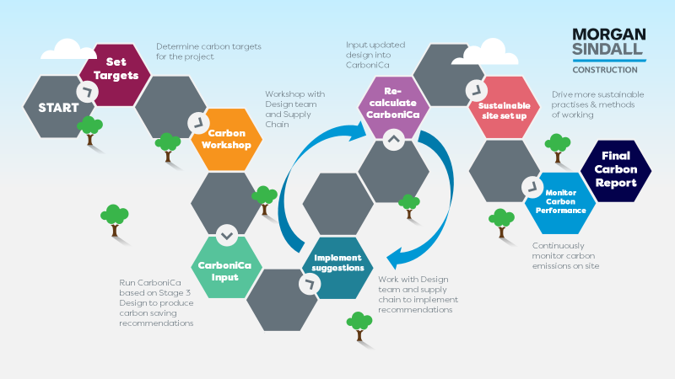
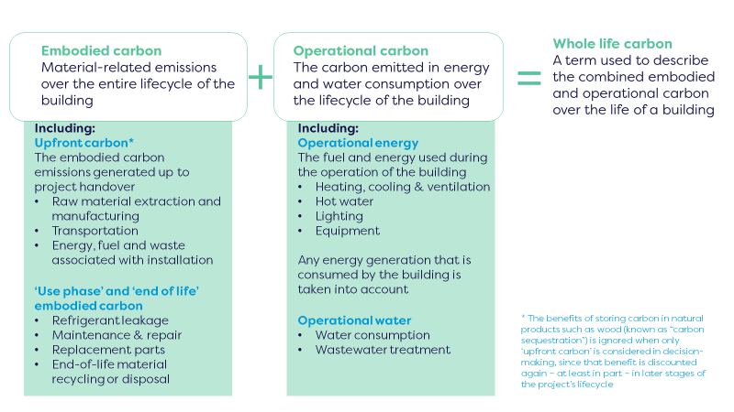
carbonica

Slide 12
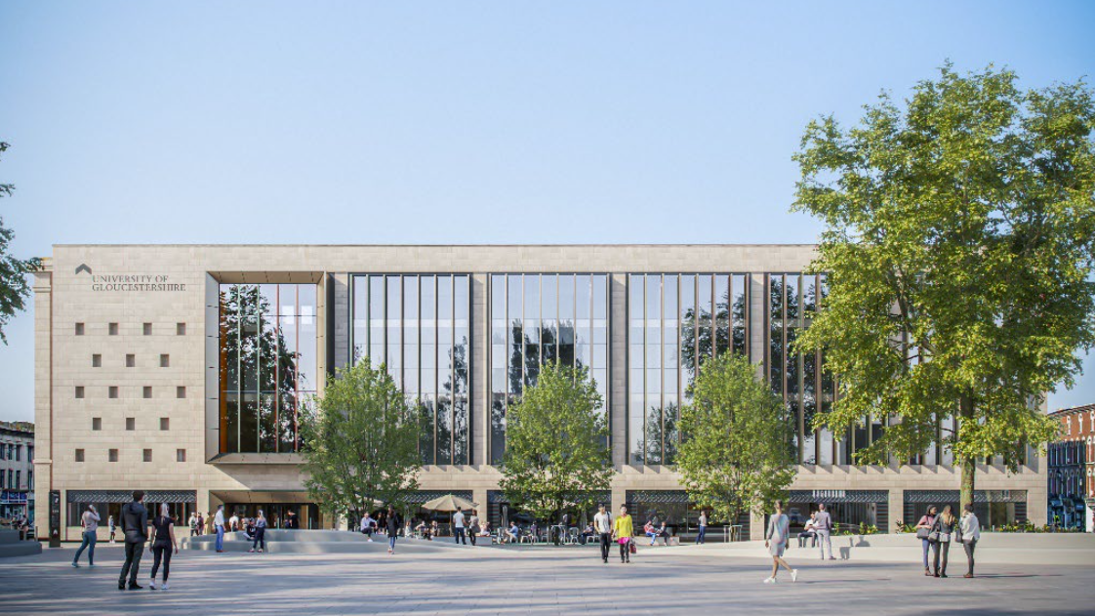
City Campus, UoG
Respecting the past, whilst reaching to the future

Slide 13
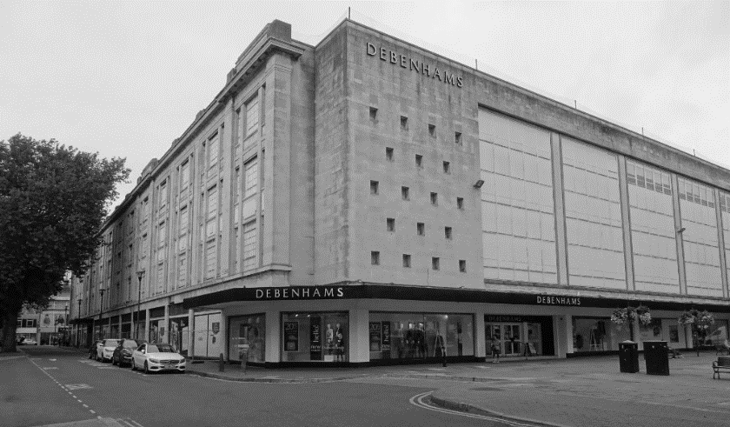
history

Slide 14
Scope
Refurbishment of derelict Debenhams building
New teaching and learning campus
Library, teaching, lecture, healthcare simulation spaces, public café and library
Pagabo framework
20,000m2 teaching space
Phase 1 - £38.4m – started on site January 2022, due for completion 2024
Phase 2 £20m – start of site 2025

Slide 15
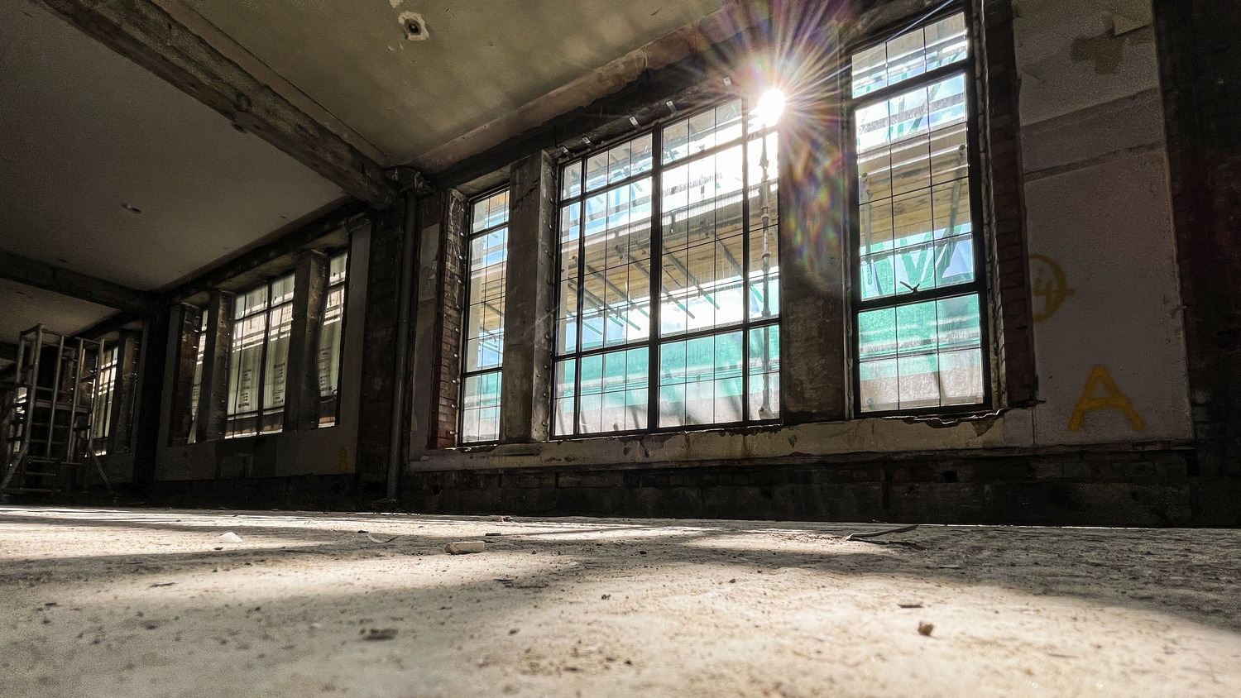
Challenges and
considerations
Not listed but had conservation considerations
Structure changes to suit new purpose / variations
No current as built information
Lack of natural light
Poor insulation
Flooding in basement
Archaeological impact of programme
Fire regulations changed due to change of use

Slide 16
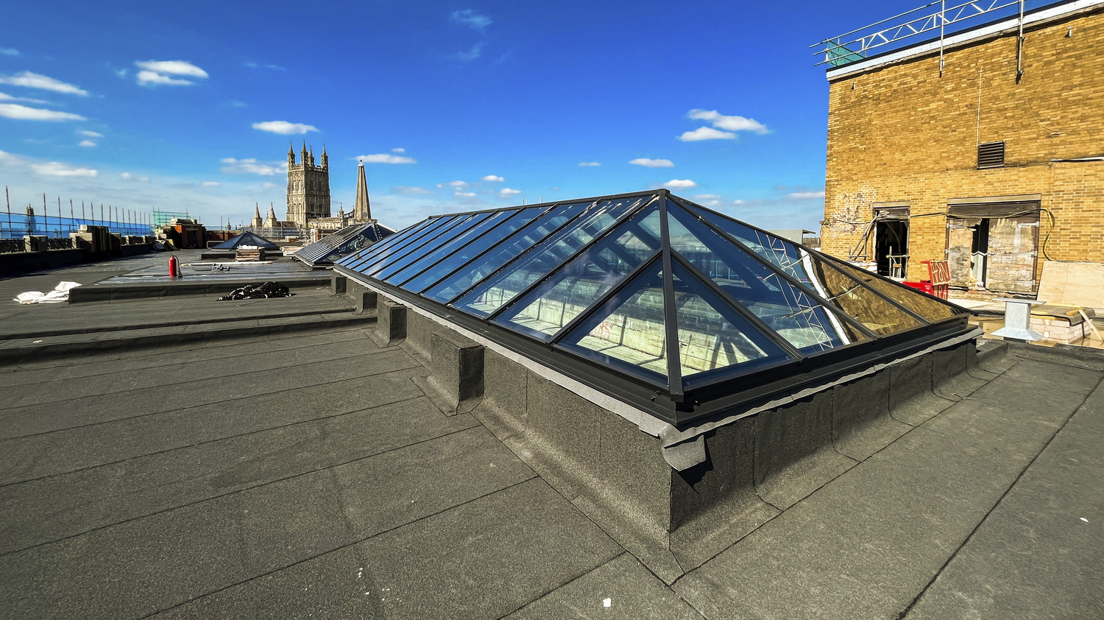
Overcoming the challenges

Slide 17
HOW DID THE CITY CAMPUS HIT THE FOUR PILLARS?
CARBON
4 PILLARS
Carbon Outcomes
COST
Cost Outcomes
ECONOMIC
This building will play a vital role in both the regeneration of the city centre and supporting the University’s ambitious plans for growth
SENSE OF PLACE
£111.6m injection into community over the lifetime of the project and more than 1600 jobs

Slide 18
HOW DID THE CITY CAMPUS HIT THE FOUR PILLARS?
“There could come a tipping point where sacrificing some embodied carbon to rebuild something that is going to be operationally more efficient and a nicer place to be (in terms of well-being and social value) will create a more compelling argument for demolition than refurbishment.”
UKGBC Developer Study 2021
“We have a collective responsibility as architects to minimise our impact on the planet’s resources and maximise the societal and economic benefits of our work. The inventive reuse of buildings is critical to reducing carbon emissions and, whilst often not the simplest solution, requires exceptional creativity and vision – I look forward to seeing some inspiring examples.”
Simon Alford, outgoing RIBA President, 2023

Slide 19
Change happens at the speed of collaboration

Slide 20
ANY
QUESTIONS?

