Slide 1
Future Skills Constructing Excellent Summit Midlands
18th October 2023

Slide 2
Contents
A summary of the challenge
Demand for what?
What the forecasts say
Productivity and net zero
Digital skills
Who will fill the roles?
How will we get them to stay?

Slide 3
2030 and beyond
The [construction] skills landscape is one where there is a shortage of suitably skilled people across large parts of the industry. Although the traditional skills will still be needed, new areas of skills in the use of and design of low carbon technologies and in digital technologies will also become important. New training providers will be required. Entry paths into the industry and communication about its attractiveness and benefits need to be made more visible.
CITB Industry Analysis and Forecasting- Future Scenarios 2023

Slide 4
Demand for what?

Slide 5
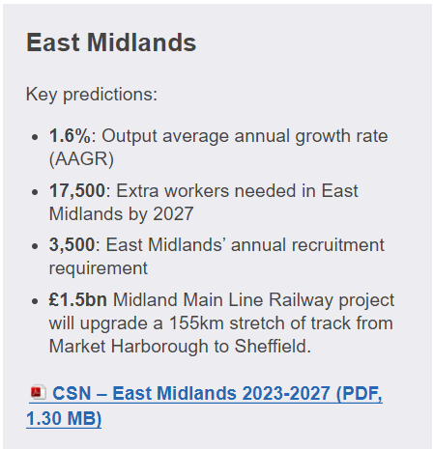
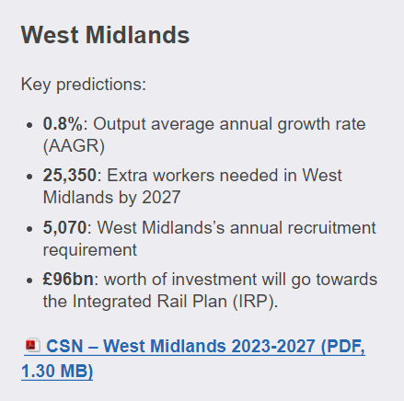
CSN forecasts 2023-27
An extra 225,000 construction workers may be needed by 2027.
Demand felt most keenly in private housing, infrastructure and repair and maintenance.
Occupations with strong ARR:
Non-construction professional,
Technical/IT,
Other construction professionals
and technical staff Construction Process Managers
Wood trades/fit out
Painting and Decorating
Plant Operatives

Slide 6
80% of homes and buildings in 2050 will be ones we’re living and working in today
500,000 deep retrofits are needed every year from 2020 to hit the Net Zero target (£300 bn)
Up to 330,000 new jobs will need to be created in energy efficiency by the end of the 2020s on current decarbonisation projections
UK retrofit demand
Notes:
Buildings constructed now will be 4 x the performance of older buildings. In terms of emissions therefore, the existing stock is responsible for 95% of the problem. Existing stock is therefore the priority for removing operational carbon.
However, when embodied carbon is considered, annual emissions from new construction, (including products, transport and construction activities) account for around a quarter of annual emissions from the sector
£300bn in domestic energy efficiency to deliver net zero - £3bn investment in a green recovery on the greens homes grant is a drop in the ocean.
Where do we get 330,000 people from? Re-skilling, new entrants.
Our skills analysis breaks this down into numbers of individual by SOC code, e.g. 10k building envelope specialists, 20k plumbing and HVAC tradespeople.

Slide 7
Priority skills that industry needs to deliver Net Zero
Enabling Roles
Retrofit designers and coordinators
Specialist building envelope and heat pump installer roles
Roles that support the delivery of MMC – designers, surveyors, installers and project managers.
Design and management roles for heat networks
Upskilling that delivers business benefits and supports net-zero
Sustainable construction awareness (introductory)
Behavioural skills
Systems thinking to build collaboration between trades
Training that targets the reduction of errors and defects
Repair, maintenance and improvement of traditional buildings (including energy efficiency retrofit).
Digital skills
Training that builds SME capability to access government-incentivised schemes, e.g. business administration
Notes:
Training that supports reduction of errors and defects = QMS, Get It Right initiative.
Green Register, Supply Chain School, Retrofit Academy. Resources such as the “Understanding Conservation” website.

Slide 8
Retrofit- Trades and professionals impacted
Trade
Roofers
Plasterers/drylining
Bricklayers
Electrical trade and installations
Heating engineers and plumbers
Wood trades and fit out (and potentially floorers)
Design and management
Retrofit Coordinators
Architects
Education and training
Trainers
Assessors
Project and site managers
Internal wall and external wall installation

Slide 9
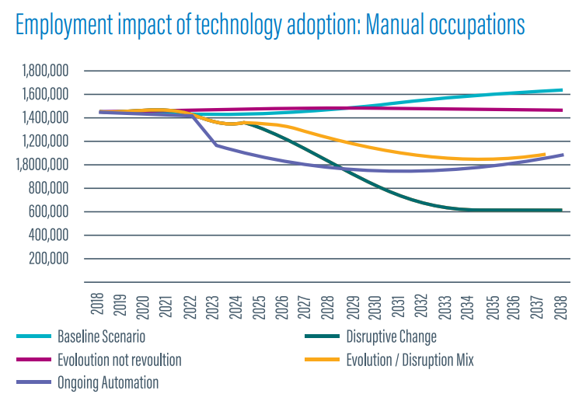
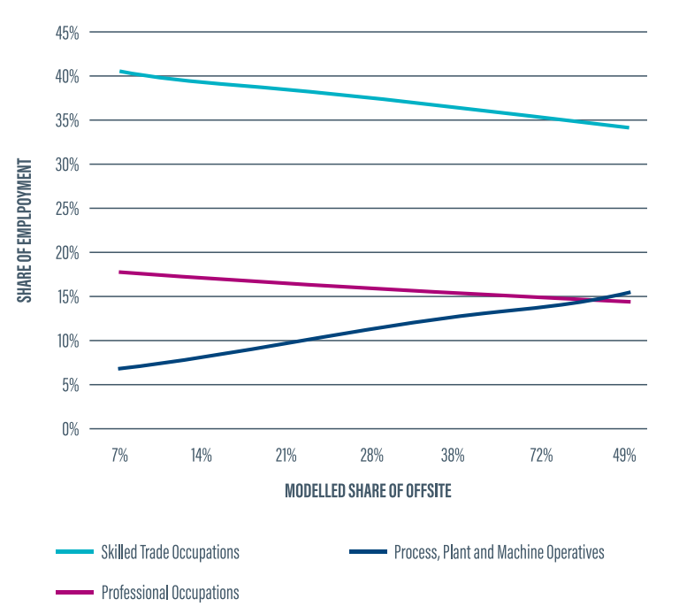
The power of disruption
Evolution or Revolution?- 2019

Slide 10
Digital
Delivering construction projects in new ways
Working across a fragmented supply chain
Supporting SMEs with essential skills for business and onsite delivery
Notes:
Digital construction is the use of technology and digital tools in the construction processes, like design, gathering of materials, and project planning. Any type of digital software or technology used as part of a construction process can be considered digital construction. Examples:
Mobile technology
Building Information Modelling (BIM)
Virtual reality
Artificial intelligence
3D printing

Slide 11
Who will fill the roles?

Slide 12
Diversity in the Sector- Labour Force Survey
 | England | Wales | Scotland
Women | 16% | 13.7% | 19.3%
Ethnicity | 7.1% | 1.8% | 2.6%
Disability | 11.3% | 12% | 10.1%
Labour Forecast Survey Summer 2020 ONS
Estimates of representation vary and protected characteristics may be hidden, but regardless, it’s clear that the sector working population does not reflect the general population
There is a difference between professional and trade roles, experiences on site or in an office
If the challenge is tackled successfully, there are major benefits for recruitment, retention and behaviours and cultures in the workplace
The structures in the sector- subcontracting and labour agency, doesn’t lend itself to tacking challenges
Notes:
CSN forecast 2022-26 indicating significant growth- this is against a backdrop of high employment levels
Data regarding LGBTQIA+ is limited- 2016 CLC estimate 97.9% of the workforce identified as heterosexual

Slide 13
How does your company compare?
The Supply Chain Sustainability School annual Diversity Survey is an aggregated, anonymous way to allow you to understand how the diversity of your workforce compares to the industry

Slide 14
Rethinking Recruitment
Notes:
Research purpose
Identify ways to:
Increase the number and diversity of new recruits
Identify what makes construction an attractive or unattractive career choice for new recruits and career changers
Explore alternative recruitment methods
Approach
The research sought the views of 1,100 individuals of working age again from a range of backgrounds
This gives us a view from those ‘outside’ of construction. In this survey; careers values, perceptions and future plans were explored

Slide 15
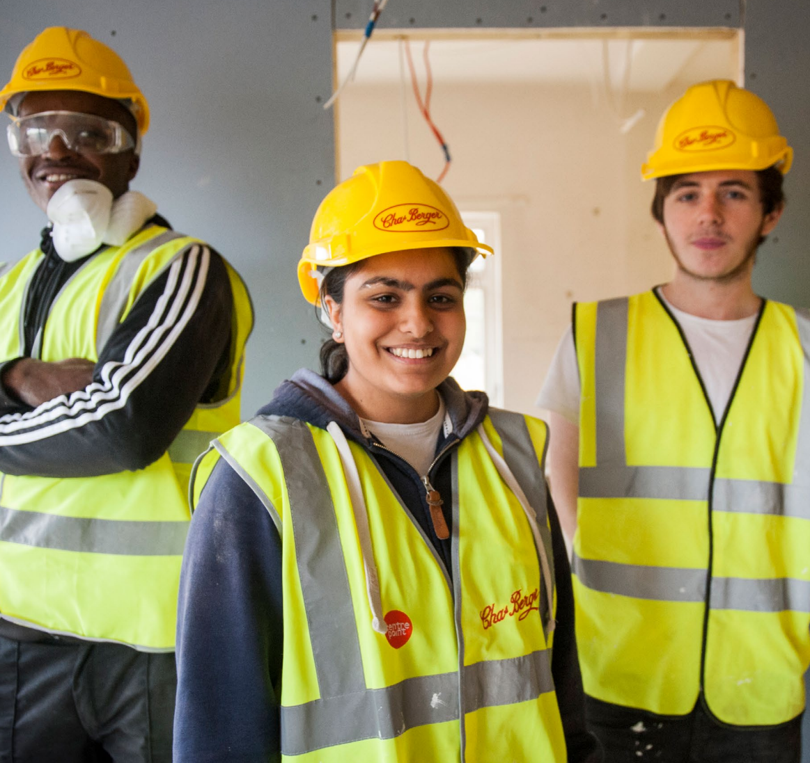
Career decisions, motivators and foundation understanding
Shared values are important
Key values are: stability, pride in work, helping others, and flexibility (+ variety/change for construction)
Key attraction factors are: work environment, employer reputation, and good salary
Shared values between construction, engineering, IT, manufacturing and transport
Some understanding of sectors before entry; entry requirements and availability of jobs
Notes:
All respondents felt it was important to work in an industry that shares their values, for construction this was the case too.
When thinking about values in a career; stability, pride in work, helping others, and flexibility were of most importance, with (+ variety/change for construction)
When thinking about attraction factors most common are - work environment, employer reputation, and good salary.
Values and attraction factors vary – background and industry, however - there are some shared values between construction, engineering, IT & communications, manufacturing (+ transport etc) so possible priority targets?
There was a tendency to have some understanding prior to entry; particularly entry requirements and availability of jobs
The most common sources of information to find out about their sector before joining were; Informed by online research, personal networks and employer websites + teachers and social media. Little insights through employer or workplace contacts or formal IAG services/professionals
Construction insiders more confident in their knowledge + find it easier to gain insights
Construction insiders rely heavily on personal networks for IAG and to find work – this can create barriers for outsiders

Slide 16
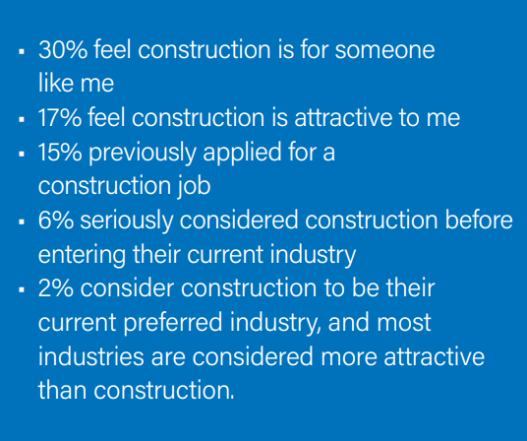
Perceptions, knowledge and attraction of construction
Mixed perceptions of the industry
Construction more attractive to those on the inside and those in engineering, manufacturing and retail
Also, those who are male, middle aged, BAME backgrounds
In comparison with other sectors, construction has an image problem
There are also widely varying experiences and perceptions within the industry- some report long inflexible working hours, others say it gives them great flexibility
Notes:
All respondents felt it was important to work in an industry that shares their values, for construction this was the case too.
When thinking about values in a career; stability, pride in work, helping others, and flexibility were of most importance, with (+ variety/change for construction)
When thinking about attraction factors most common are - work environment, employer reputation, and good salary.
Values and attraction factors vary – background and industry, however - there are some shared values between construction, engineering, IT & communications, manufacturing (+ transport etc) so possible priority targets?
There was a tendency to have some understanding prior to entry; particularly entry requirements and availability of jobs
The most common sources of information to find out about their sector before joining were; Informed by online research, personal networks and employer websites + teachers and social media. Little insights through employer or workplace contacts or formal IAG services/professionals
Construction insiders more confident in their knowledge + find it easier to gain insights
Construction insiders rely heavily on personal networks for IAG and to find work – this can create barriers for outsiders

Slide 17
Experiences of construction and future intentions
Generally positive experiences and expectations were met
Plan to stay in the industry and can see progression opportunities
Diversity – changing? Despite statistics that show the industry lacks diversity, many of those within it consider the workforce to be diverse
Would promote the industry
Consider leaving – push/pull factors
Notes:
On the whole those in construction tend to have positive experiences of the industry with good experiences when first starting such as; informal inductions, supportive colleagues, visible career pathways
Expectations of the industry were met. This could be because their expectations were low in the first place, or they didn’t have any expectations.
Those who are in the industry plan to stay (at least in the short term) to use skills and qualifications, enjoy the work and pay, and see the industry can offer progression opportunities either by moving employer or become self employed.
Insider respondents noted that they felt the industry was becoming more diverse, but there were still incidents of discrimination– further research probably needs to be carried out here to address this issue.
Individuals have and would promote the industry but suggest doing research and understanding employers values/culture is important.
However, there are factors in which would make them consider leaving the industry – these were they wanted to improve their work/life balance, because they would want to change occupation, because they felt the pay had become unsatisfactory, or there was a lack of promotion or career opportunities, and the physical demands of the work.
Or equally better pay elsewhere or retraining.

Slide 18
Recommendations
Try different methods to attract potential recruits
Develop employment practices
Cultural transformation
Individuals’ expectations of the workplace are changing, industry aligns itself with these
Employers should highlight the values important to them to help candidates identify common ground
Change perceptions
Those outside the industry tend to have a more narrow, negative view of construction, whereas those inside have a much more positive perception
Younger entrants report fewer positive experiences and require more support
Flexible working is highly valued but formal arrangements in construction are rare
It remains clear from the research that some antiquated attitudes and behaviours can deter many potential recruits
Utilising the voices of insiders could be key to changing outsiders’ perceptions
The sector must demonstrate consistently that it is for everyone – positive, fair, welcoming and makes provisions for people’s differences
Structured induction programmes and training can improve retention rates

Slide 19
Growing the recruitment pool now
Finding new candidates
Reviewing how/where vacancies are advertised, essential criteria, interview processes
Working with organisations who can help you recruit from a wider pool e.g.
Universities and Colleges
Apprenticeship providers
TRS/Talentview Construction
Onsite Hubs, Construction Bootcamps
Social enterprises, Charities and Housing Associations
Help from your local CITB Advisor
Retaining staff
Clear progression pathways
Focussing on wellbeing and work life balance as well as salary + benefits
People centred L&M and succession planning
Induction programmes, coaching and mentoring
For apprentices and graduates- clear roles and responsibilities and ownership of progress reviews
Improve diversity

Slide 20
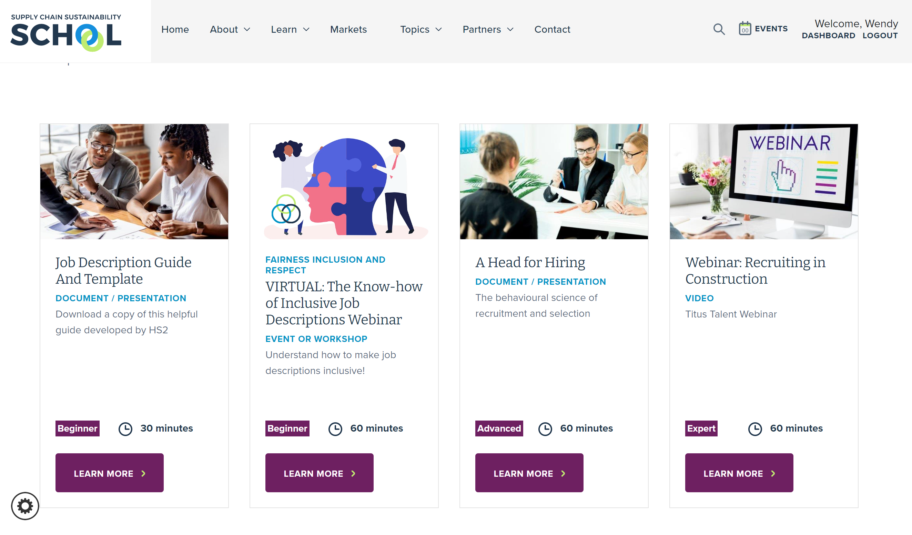
Fairness Inclusion and Respect Training
Free training and resources for the construction sector provided by the Supply Chain Sustainability School

Slide 21
Thank you
Wendy Osborn, Engagement Director England
Wendy.Osborn@citb.co.uk
07557548969

