Slide 1
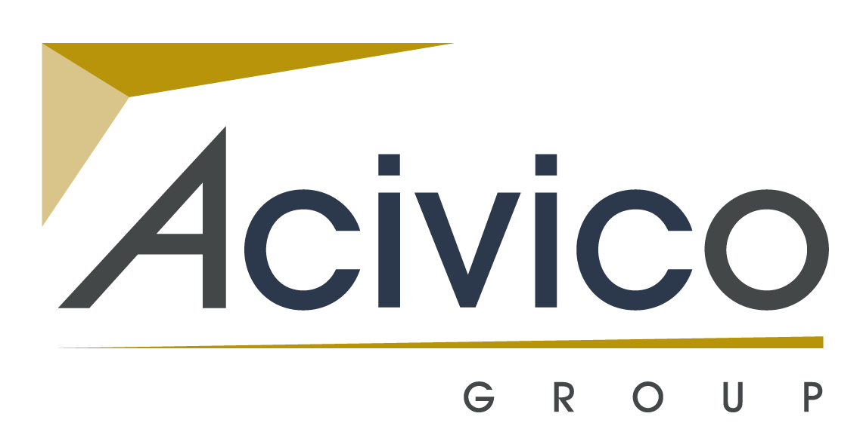
Acivico is an exciting multi-disciplined company which offers clients across the private and public sector a range of services including; Design, Construction, Facilities Management and Building Control.
Building Safety

Slide 2
A briefing paper in respect of the regulatory changes and new obligations of all of those involved in the design, construction and management of buildings can be found on the Acivico Group website.
Further information can be obtained by
Contacting the session chairman,
Kevin Blunden
at Acivico Building Consultancy

