Slide 1
Future Home Standard 2025
5 June 2023

Slide 2
🤔

Slide 3
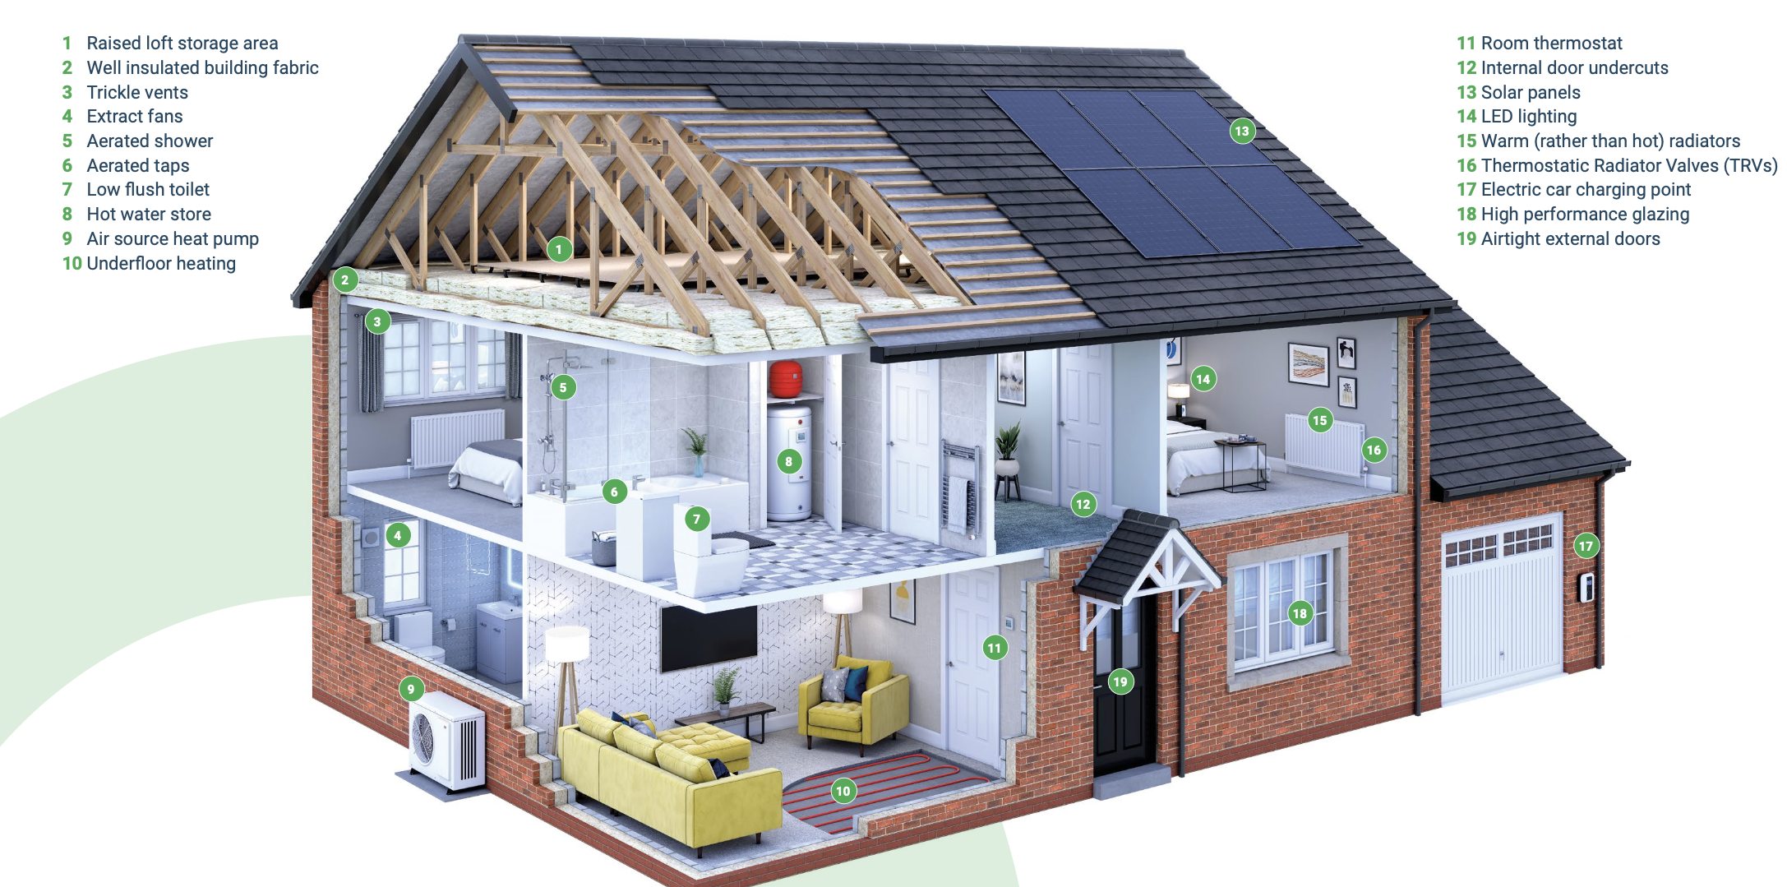

Slide 4
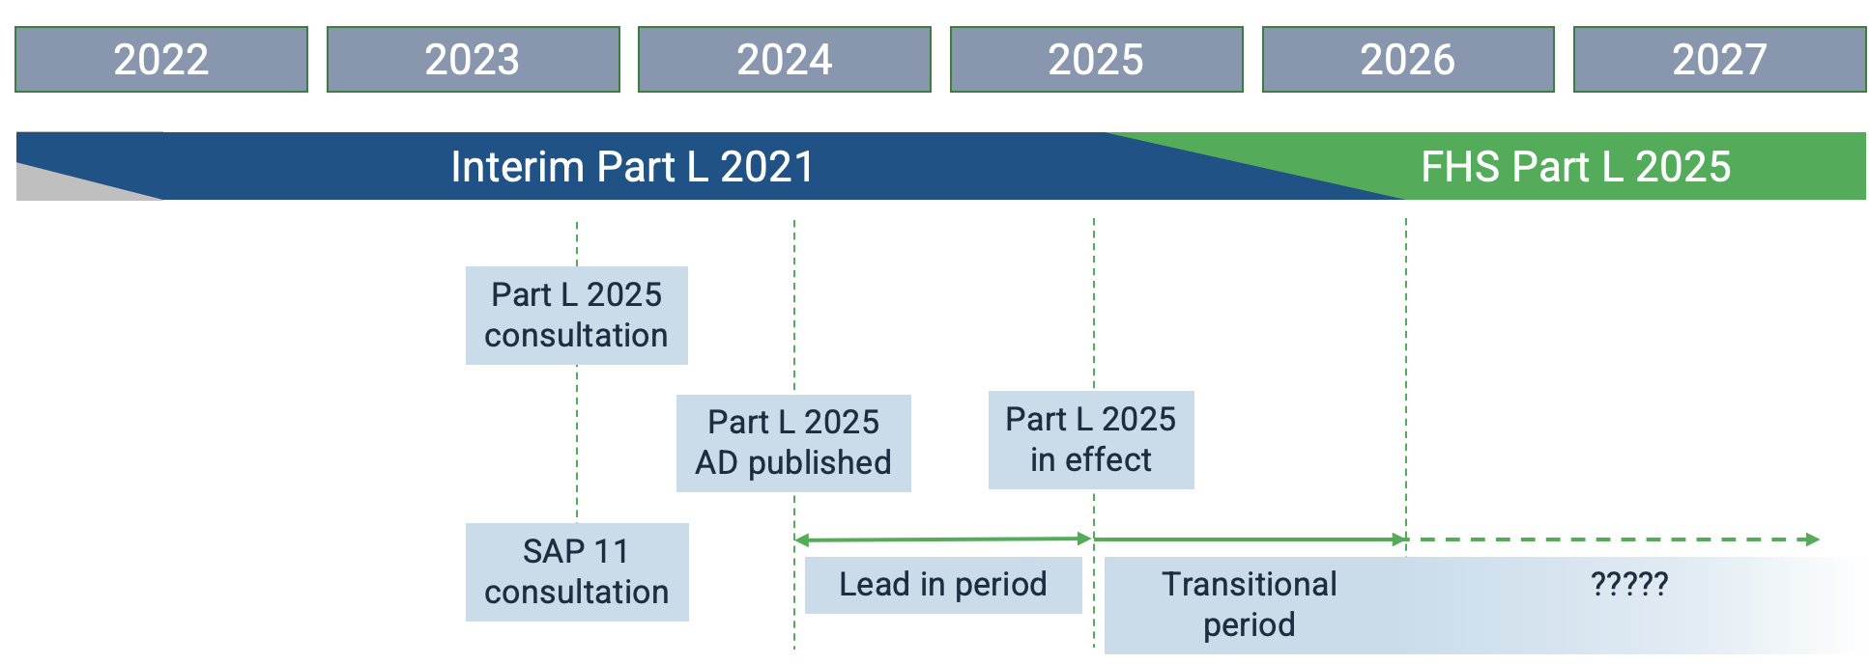
FHS 2025 Draft timeline

Slide 5
www.futurehomes.org.uk/library

Slide 6
Refining the FHS 2025 Task Group
Future Homes Standard –what should it be?
In numbers:
170 people
20 work groups
8 weeks
2 Day in-person meeting Lots of effort!
Future Homes Hub FHS request
Refining the 2025 Future Homes Standard
Future Homes Hub Task Group
Terms of Reference
25th August 2022
Introduction
The Government has committed to consulting on the Future Homes Standard in Spring 2023. The Government have committed that the Future Homes Standard will deliver zero carbon ready homes, with low carbon heating and high fabric standards, that will require no future retrofitting.
The development of such a flagship policy is necessarily complex and challenging, and there are many different as- pects and questions to be explored and understood in order to support the development and refinement of a standard for consultation. Input from all stakeholders is crucial to achieving this.
The Future Homes Hub is proposing the establishment of a task group to consider and collect evidence to inform some of these questions and this paper outlines the key questions and context the Department for Levelling Up, Housing and Communities (DLUHC) would like support with and the proposed terms of reference.
Context
The timeline for developing the FHS specification is short. The DLUHC intend to launch a public consultation in Spring 2023. As part of the preparation for the consultation and the wider changes, DLUHC need to gather evidence and infor- mation which will inform policy proposals. DLUHC are looking to gather as much information as possible before the end of this year in order that there is adequate time to carry out detailed modelling and analysis and go through the required Government procedures before the public consultation.
As part of this information gathering, DLUHC are seeking evidence on particular questions and objectives that are integral to the policy development process, and obtaining this evidence by consulting stakeholders. The Hub can have a particular role to play in drawing on its sector representation to provide an evidenced view on the reality of implemen- tation at scale, with a particular focus on the impact on SMEs. Details of each individual aspect are laid out below.
Questions / objectives for the Task Group and timings
Summarise what new technologies and approaches homebuilders are considering using to deliver the Future
Homes Standard and the benefits and challenges of each.
Have any homebuilders begun early designs of possible FHS homes? What technologies do these designs include?
What technologies would you suggest are integrated into the notional building specification for the Future Homes Standard?
Notes:
Not to make recommendations or comment on what was ‘good’ or ‘bad’ but simply to provide evidence.

Slide 7
Contender Specifications – at a glance
Elements | CS1 | CS2 | CS2a | CS3 | CS4 | CS5
Fabric (compared to 2021) | Little worse | Equal |  | Better | Much better
Glazing | Double |  |  |  | Triple
Air permeability | 5 | 4.5 -5 |  | 3 | 1 | 0.5
Ventilation | dMEV |  |  | MVHR
Space heating | ASHP |  | IR | ASHP |  | None
Water heating | ASHP | ASHP WWHR | Immersion | ASHP WWHR |  | ExAHP WWHR
Renewables | None | PV | Max PV + Battery | PV
Elements | CS1 | CS2 | CS2a | CS3 | CS4 | CS5
Fabric (compared to 2021) | Little worse | Equal |  | Better | Much better
Glazing | Double |  |  |  | Triple
Air permeability | 5 | 4.5 -5 |  | 3 | 1 | 0.5
Ventilation | dMEV |  |  | MVHR
Space heating | ASHP |  | IR | ASHP |  | None
Water heating | ASHP | ASHP WWHR | Immersion | ASHP WWHR |  | ExAHP WWHR
Renewables | None | PV | Max PV + Battery | PV

Slide 8
Approach

Slide 9
How would the contender specification be delivered at scale?
Ventilation
Planning
Grid
Heat pumps
Airtightness
Consumer journey
Skills
Costs
High rise
Transitional arrangements
Manufacturing capacity
Design
Fabric
Small builders
Metrics

Slide 10
Outcomes / Factors determining choices including:
Build cost:
CS1 to CS5 in 2022, relative to Ref2025: From £3k less to £17k more
Impact on UK electricity demand at a national level:
higher performing CSs would save over 600 GWh/year Generation capacity.
Air permeability level:
the challenges and implications of step changes in build techniques and quality control.
Mechanical Ventilation Heat Recovery (MVHR):
the challenges and implications of step changes for builders and householders.
Householder energy bills:
CSs range from £190 increase to £450 saving per year compared with the 2021 regulations.
Transitional
arrangements:
the timescales needed to secure change at scale safely for different CSs.
and many others…..

Slide 11
26 Recommendations for effective implementation
…but these 7 underpin the others:
Establish an Industry Government FHS Implementation Board
Sub groups: Consumer, Small Builder, Heat pump, Ventilation, Airtightness, Energy Flexibility
Announce key decisions as early as possible
Provide a stable and consistent version of SAP11 in good time
Provide sufficient Transitional Arrangements
Establish and enforce new build homes competency schemes
Covering: airtightness, ventilation and heat pumps
Learn from UK and international leaders in net zero homes
Develop performance measurement techniques
Notes:
Announce key decisions as early as possible and include sufficient detail, to give industry time to prepare.
Provide a stable and consistent version of SAP11 in good time to enable industry to prepare and develop solutions.
Provide sufficient Transitional Arrangements based on robust understanding of the operational timescales for redesigning homes at scale and which enable a progressive implementation of the FHS.
Establish and enforce new build homes competency schemes covering airtightness, ventilation and heat pumps due to the risks highlighted in these areas.
Learn from UK and international leaders in net zero homes such as Sweden and Norway and on experience rolling out specific technologies like cMEV and MVHR.
Develop performance measurement techniques to better understand ‘as built’ performance as designed performance improves.

Slide 12
26 Recommendations for effective implementation
…but these 7 underpin the others:
Establish an Industry Government FHS Implementation Board
Sub groups: Consumer, Small Builder, Heat pump, Ventilation, Airtightness, Energy Flexibility
Announce key decisions as early as possible
Provide a stable and consistent version of SAP11 in good time
Provide sufficient Transitional Arrangements
Establish and enforce new build homes competency schemes
Covering: airtightness, ventilation and heat pumps
Learn from UK and international leaders in net zero homes
Develop performance measurement techniques
Notes:
Announce key decisions as early as possible and include sufficient detail, to give industry time to prepare.
Provide a stable and consistent version of SAP11 in good time to enable industry to prepare and develop solutions.
Provide sufficient Transitional Arrangements based on robust understanding of the operational timescales for redesigning homes at scale and which enable a progressive implementation of the FHS.
Establish and enforce new build homes competency schemes covering airtightness, ventilation and heat pumps due to the risks highlighted in these areas.
Learn from UK and international leaders in net zero homes such as Sweden and Norway and on experience rolling out specific technologies like cMEV and MVHR.
Develop performance measurement techniques to better understand ‘as built’ performance as designed performance improves.

Slide 13
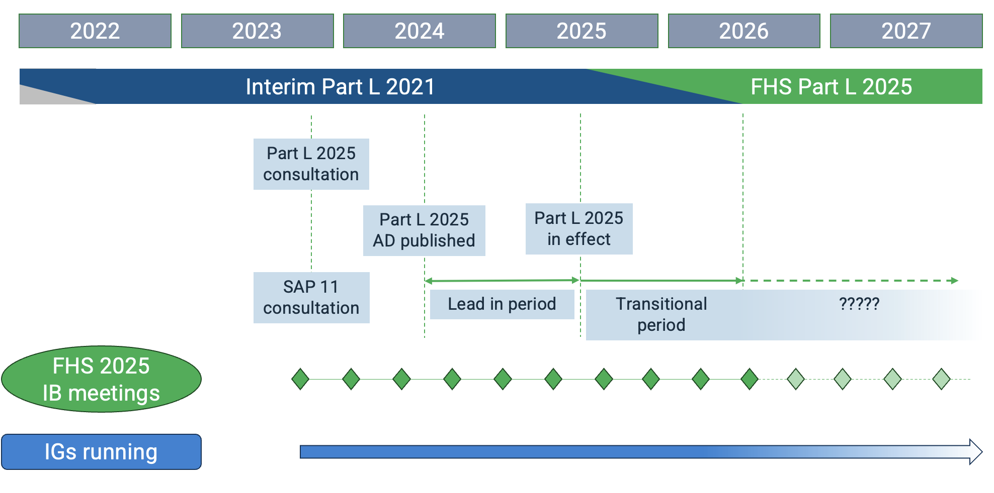
FHS2025 Implementation board

Slide 14
Guidance….
www.futurehomes.org.uk/library

Slide 15
(Image credit: Persimmon PLC)
David Adams
Strategic Advisor
Future Homes Hub
david@adamsd.co.uk

