Slide 1
disruptive sustainability
Georgia
Elliott-smith
Notes:
About me – 25yrs as env eng & consultant. Journey as an activist = legal action against UK govt.
Seen sustainability become nothing more than marketing exercise.
At COP26, I was sickened by the corporate CEOs and sustainability managers flooding the event, telling us we could fix the planet if we buy more of their stuff.
The top 5 ESG-rated companies in the FTSE For Good index last year were a tobacco company, a mining giant, and the world’s top plastic polluter. FTSE 100 – the 5 highest ESG rated companies | Hargreaves Lansdown (hl.co.uk)
Standards and certifications we are using are not even addressing the core business model. The tools we use to measure and report ESG are fundamentally flawed.
Core principles to ensure we set the right course….

Slide 2
sustainability
Notes:
A simple request but one that is unthinkable for most companies.
Be humble and honest about your current performance. Be clear about what you’ve included in your reporting and what’s excluded.
Talk about the challenges and blockers.
No greenwash.

Slide 3
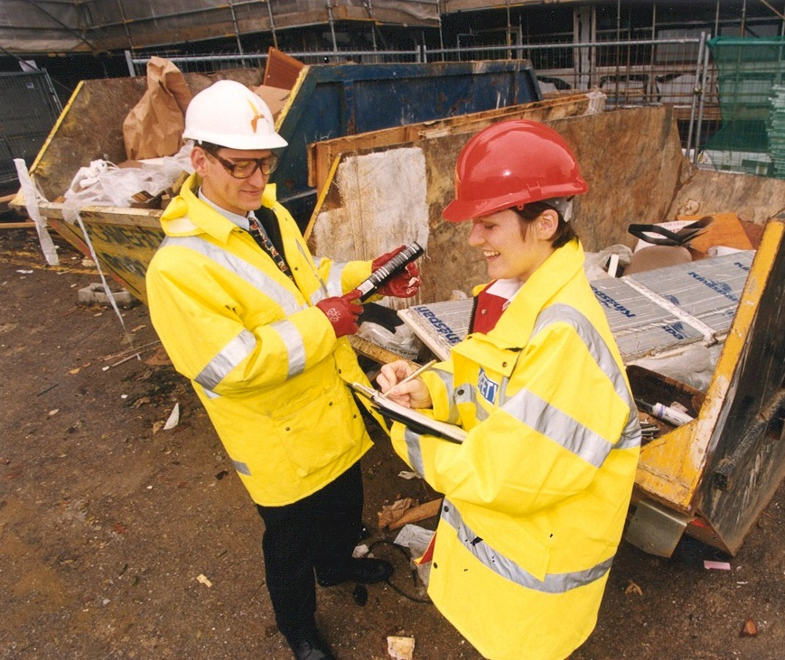

Slide 4




Slide 5

Notes:
Created in 2015, goal to be achieved by 2030.
Can be used at international level to set policies. But also at the level of a single company or product.
This IS your business. Everything you do as a company can slot into this framework. HR, accounts, procurement, sales, operations.
Consider NO POVERTY & your role in zero hour contracts.
Transition away from function-based jobs into purpose-based jobs.
HR colleagues could feel amazing about leading gender equality / quality education / reduced inequalities.
No poverty becomes the purpose of your payroll and procurement colleagues.
Notice Goal 8 – economic growth.
SUSTAINABILITY IS EVERYONE’S JOB! Can’t be the job of a single beleaguered sustainability manager or a voluntary committee working in their lunch break.

Slide 6
circularity
Notes:
A simple request but one that is unthinkable for most companies.
Be humble and honest about your current performance. Be clear about what you’ve included in your reporting and what’s excluded.
Talk about the challenges and blockers.
No greenwash.

Slide 7
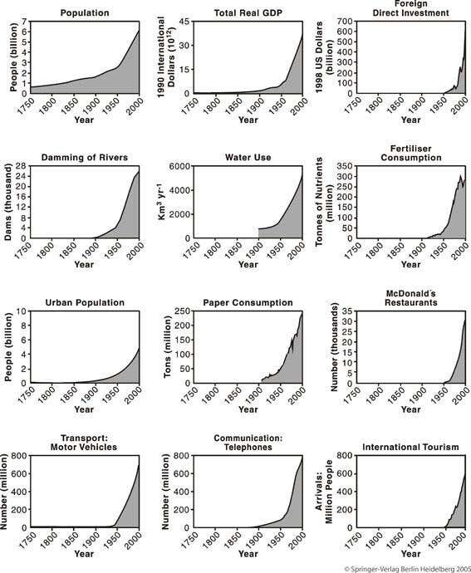

Slide 8
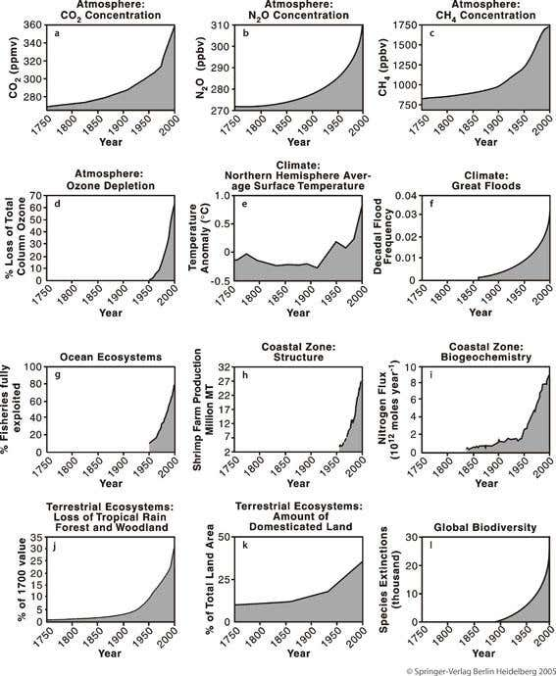
Notes:
Big issue for retail.
Don’t focus on selling things that are recycled.
Think about the problems your product creates in the environment. Does it create waste or pollution? What part can you play in reducing this?
Repairability, durability, take-back for repair.
Are you using sales techniques that enticing people to buy stuff they don’t need?

Slide 9
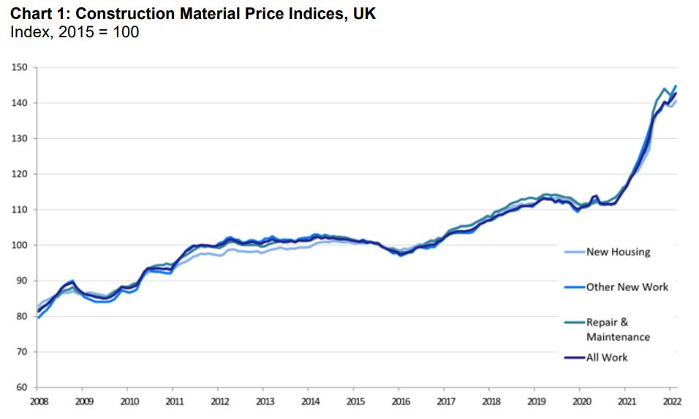
Source: BEIS, Monthly Statistics of Building Materials and Components Commentary, March 2022

Slide 10
Net zero buildings
Notes:
A simple request but one that is unthinkable for most companies.
Be humble and honest about your current performance. Be clear about what you’ve included in your reporting and what’s excluded.
Talk about the challenges and blockers.
No greenwash.

Slide 11
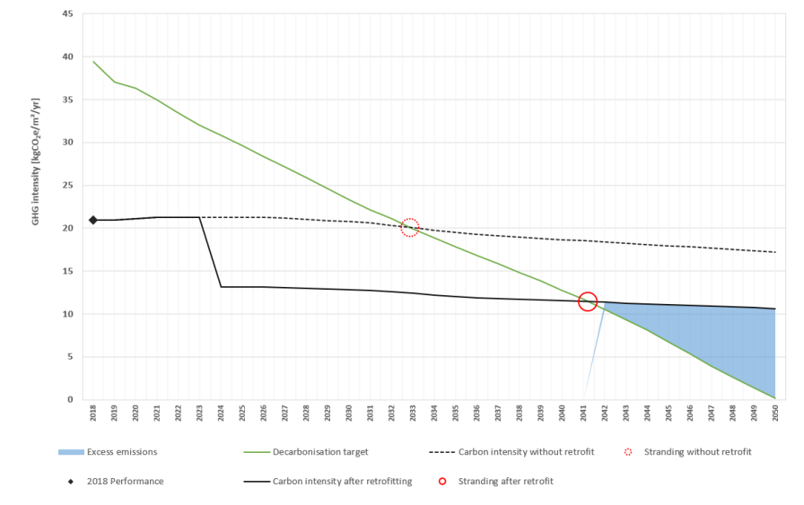

Carbon stranded assets

Slide 12
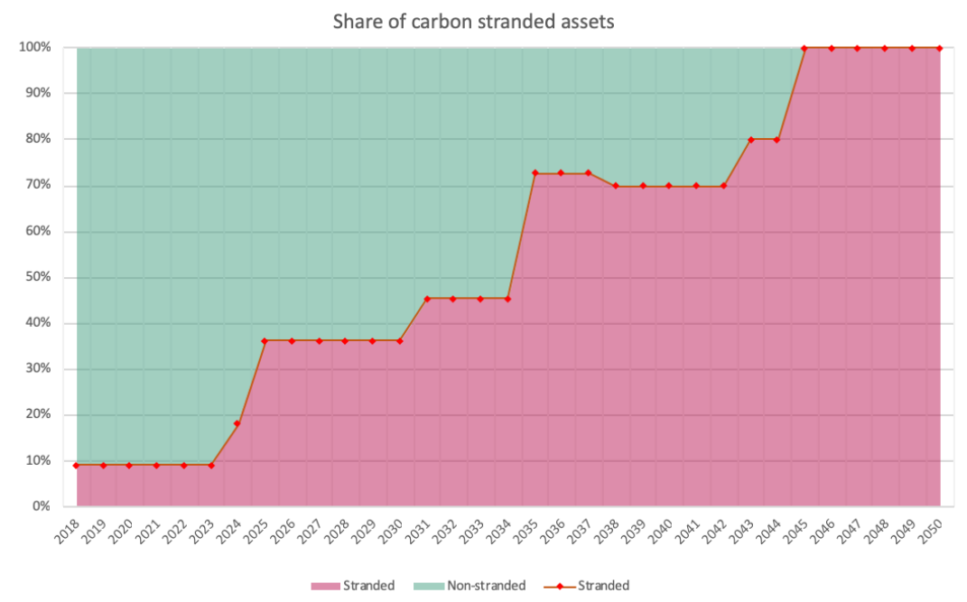
Notes:
Big issue for retail.
Don’t focus on selling things that are recycled.
Think about the problems your product creates in the environment. Does it create waste or pollution? What part can you play in reducing this?
Repairability, durability, take-back for repair.
Are you using sales techniques that enticing people to buy stuff they don’t need?

Slide 13


Notes:
The Climate Change Act, passed November 2008. It sets out emission reduction targets that the UK must comply with legally. It represents the first global legally binding climate change mitigation target set by a country. The Act committed the UK to reducing its greenhouse gas emissions by 80% by 2050, compared to 1990 levels. This was made more ambitious in 2019 when the UK became the first major economy to commit to a ‘net zero’ target by 2050.
Paris ratified by UK in 2016, IPCC report 2018.
TCFD report 2017 – Mark Carney & Michael Bloomberg. Nov 2020, announced that UK will make TCFD-aligned disclosures mandatory across the economy by 2025, with a significant portion of mandatory requirements in place by 2023. The Roadmap presents a coordinated strategy for 7 categories of organisation: listed commercial companies; UK-registered companies; banks and building societies; insurance companies; asset managers; life insurers and FCA-regulated pension schemes; and occupational pension schemes.
SECR 2018 = Large companies that meet two or more of the following criteria:
turnover (or gross income) of £36 million or more,
balance sheet assets of £18 million or more,
250 employees or more.

Slide 14
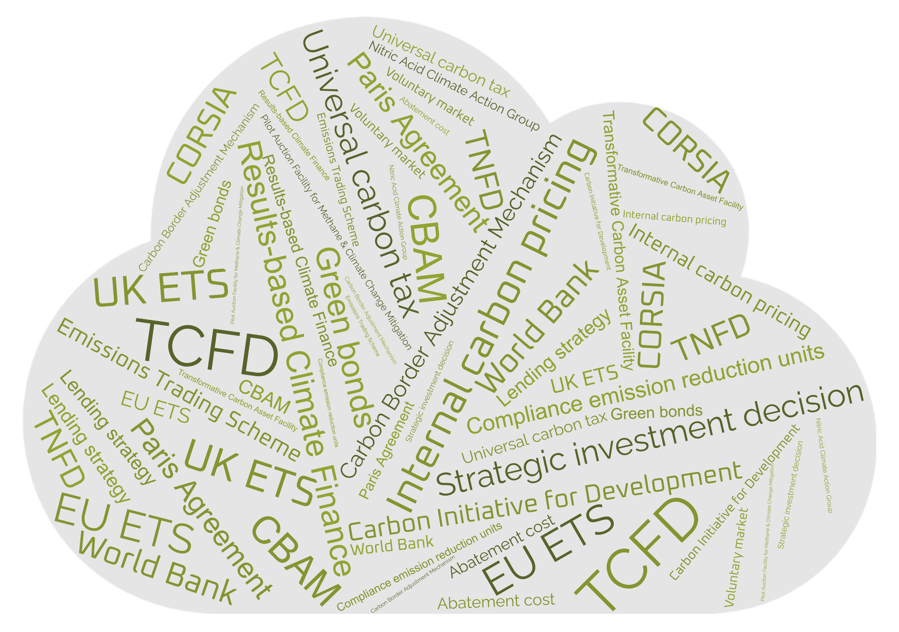
Notes:
Incremental change is not good enough.
10% less carbon or 20% less waste sounds good. But the correct response to these targets is “so what?”. Does it matter? Or should we be cutting our waste by 90% in order to be truly sustainable?
First we must start by making an searching and fearless inventory of the harms we are engaged in.
Meaningful change demands three things:
the passion to fearlessly explore your impacts,
the power to effect real change, and
the knowledge of what meaningful change looks like.
So where do we start? NEXT SLIDE - SDGs

Slide 15
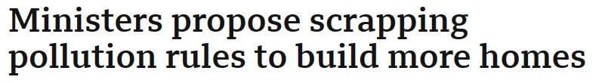
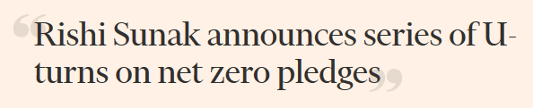


Slide 16
Change the system
Notes:
Keeping our own house in order is good, but IT’S NOT ENOUGH.
All good intentions. But sustainability costs money.
Almost all climate action is voluntary.
CAPITALISM = need a carbon tax.
You are the expert – you know what the blockers are. 5 year old – WHY???
If you’re not lobbying, who is??

Slide 17
BUILDING
THE FUTURE
element4.co.uk
georgia@element4.co.uk

