Slide 1


2024 Awards Launch
Mott Macdonald Offices, Birmingham
Tuesday 26th September 2023
Presentation by Andrew Carpenter, Chief Executive
Constructing Excellence Midlands
@cemidlands
W: cemidlands.org
E:info@cemidlands.org

Slide 2

@cemidlands
W: cemidlands.org
E:info@cemidlands.org

Slide 3



About us
CE Midlands is the regional arm of Constructing Excellence
Cross-industry, cross supply chain, member led organisation
Building, Housing, Infrastructure & FM
A platform for industry improvement to deliver better value for clients, industry and users through collaborative working
Not-for-profit best practice and knowledge transfer organisation
We use the knowledge to influence change & network with like minded professionals

Slide 4

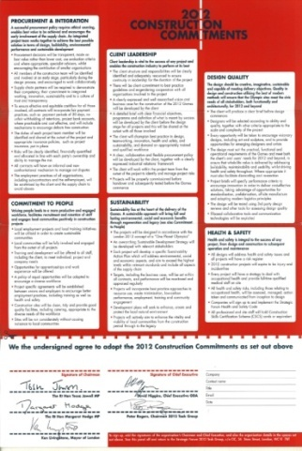

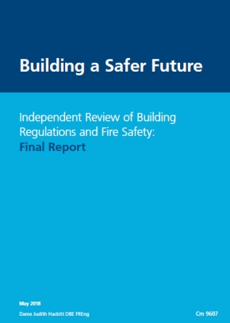
UK construction improvement can be charted by a number of key reports
Latham…….Egan……Olympics…..’Crisis…....2025…….Farmer……Hackitt
1994.......1998.........2006…...2010…2013……2016…2018

Slide 5
Our mission
Positively disrupting the industry delivery processes to transform performance

Slide 6
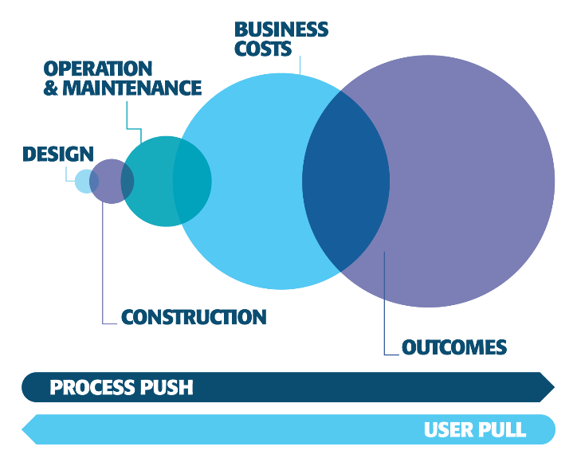
Our vision
Superior outcomes from new delivery models featuring:
A client-led transformation by procuring for outcomes and value for all stakeholders
Integrated teams working collaboratively with long-term relationships and aligned commercial arrangements
Health and Wellbeing, Equality, Diversity & Inclusion is at our heart
A Greener, Safer, Smarter industry

Slide 7
C E Midlands
Board of 18 chaired by Uma Shanker, Severn Trent Water
Four Thought Leadership Theme Groups
Six Best Practice Clubs
Four Forums
G4C network
Annual East & West Midlands Awards
Annual Construction, Housing & Infrastructure Summits
Diploma in collaboration in construction
Leadership Dinners & other events
Monthly webinars

Slide 8
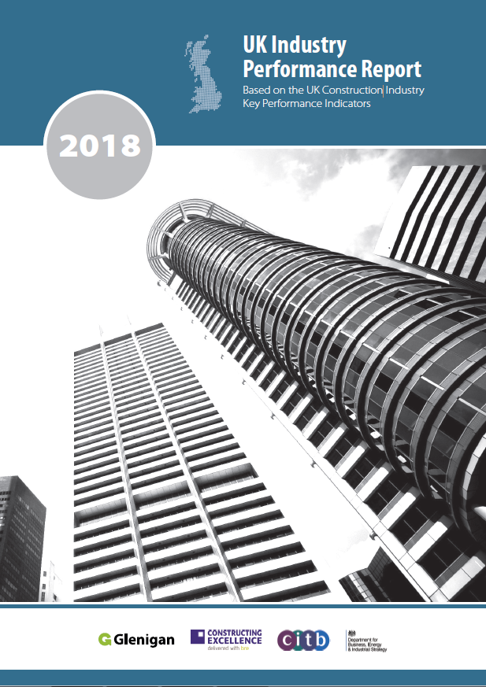
Putting data at the heart of Constructing Excellence
Constructing Excellence has a two decade track record at the forefront of performance measurement through our construction industry KPIs
UK Industry Performance Report published each year since 1999, now in partnership with Glenigan
Measuring performance is core to delivering our vision of excellence
We regularly refocus on this agenda with a programme of activity each year

Slide 9
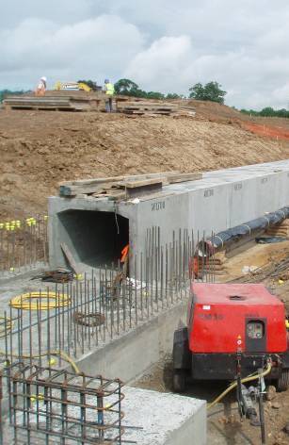
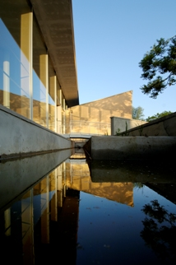
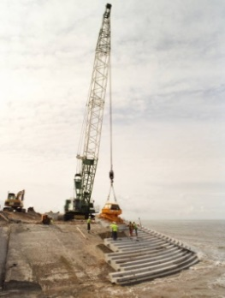
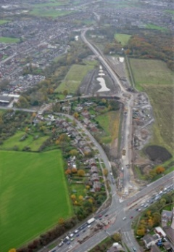

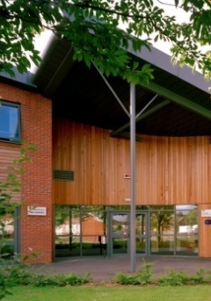
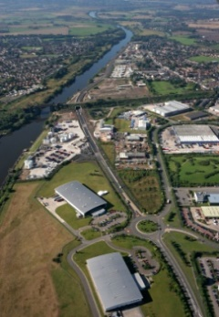
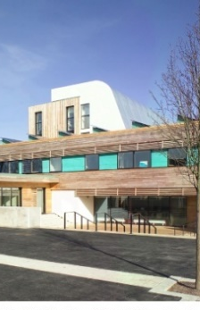
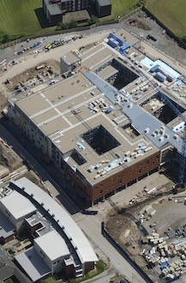
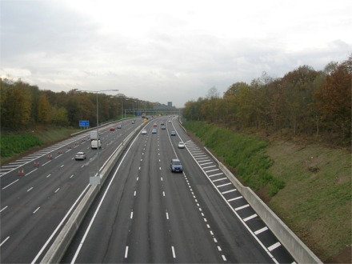
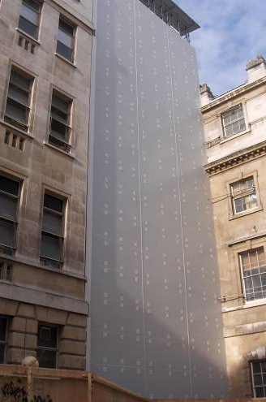
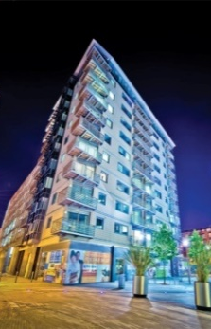
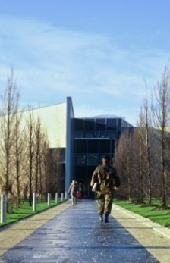
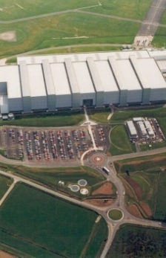
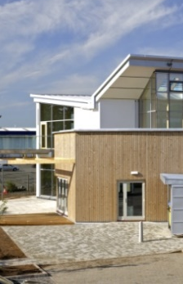
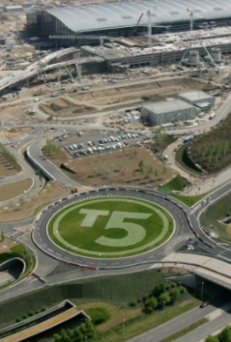
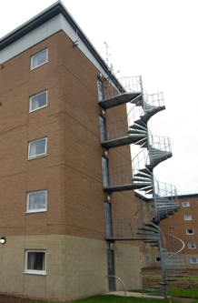
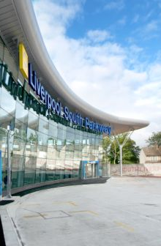
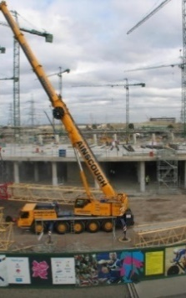
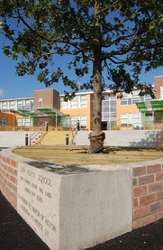
Over 500 Demonstrations from all sectors, regions and sizes

Slide 10
Demonstration projects out-perform the rest of the industry
770
350
2Pan-industry performance = 100
300
250
200
150
100
50
0
Defects
Safety
Productivity
Staff Turnover
Construction Time
Construction Cost
Qualifications & Skills
Client Satisfaction - Service
Predictability Cost - Design
Profitability
Employee Satisfaction
Client Satisfaction - Product
Predictability Time - Design
Environmental Impact Process
Environmental Impact Product
Predictability Cost - Construction
Predictability Time - Construction
Safety - All Companies
Safety - Companies T/O > £10m

Slide 11
2024 Awards Dates
G4C Friday 22nd March, Macdonald Burlington Hotel, Birmingham
West Midlands Thursday 2nd May, Edgbaston Cricket Ground, Birmingham
East Midlands Thursday 27th June, The Athena, Leicester
National Finals, London date to be announced

Slide 12
2024 Awards Categories
Building Project of the Year
Residential Project of the Year
Infrastructure Project of the Year
Regeneration & Retrofit Project of the Year
Client of the Year
Delivering Value Award
People & Culture Award
Innovation Award
Climate Action Award
Integration & Collaborative Working Award

Slide 13
2024 Awards Categories
SME of the Year
ESG Award
G4C Future Leader Award
CE Midlands only
  Achiever of the Year
  Winner of Winners
Drinks Reception
Headline Sponsor

Slide 14
Sponsorship Reference
​mp4 icon CE Midlands_benefits of awards sponsorship_Video.mp4

Slide 15
2024 Awards Discussion Points
Judging Process
Judging Dates
  G4C w/c 22nd January 2024?
  West Midlands w/c 26th February 2024?
  East Midlands w/c 22nd April 2024?
Awards Dinner
  Presenter
  Timings
  Entertainment
  Interviews
  Cost of tickets

Slide 16
Thank you for listening
Andrew Carpenter, Chief Executive
Constructing Excellence Midlands
@cemidlands
W: cemidlands.org
E:info@cemidlands.org

