Slide 1
Achieving Net Zero in the Built Environment
Constructing Excellence Midlands Construction Summit
18 October 2023

Slide 2

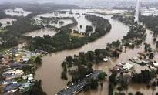



Construction challenges are societal challenges: climate change, demographic change and social equity
Climate Change
The frequency of extreme weather events has increased. Heatwaves are 2.8x more frequent, extreme rainstorms 1.3x more frequent (IPCC).
Demographic Change
Globally, the number of people aged over 65 is projected to double by 2050.
By 2066, Government estimates there will be 8.6m more people aged over 65 (25% of the population).
“Our categorical imperative is action to clear the slums. We can’t let minorities dictate that this century-old chore will be put off another generation or finally abandoned.” Robert Moses
Equity
Infrastructure investment has mostly focused on provision, reliability and cost, rather than societal equity.

Slide 3
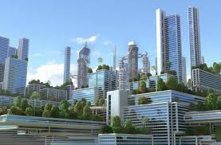
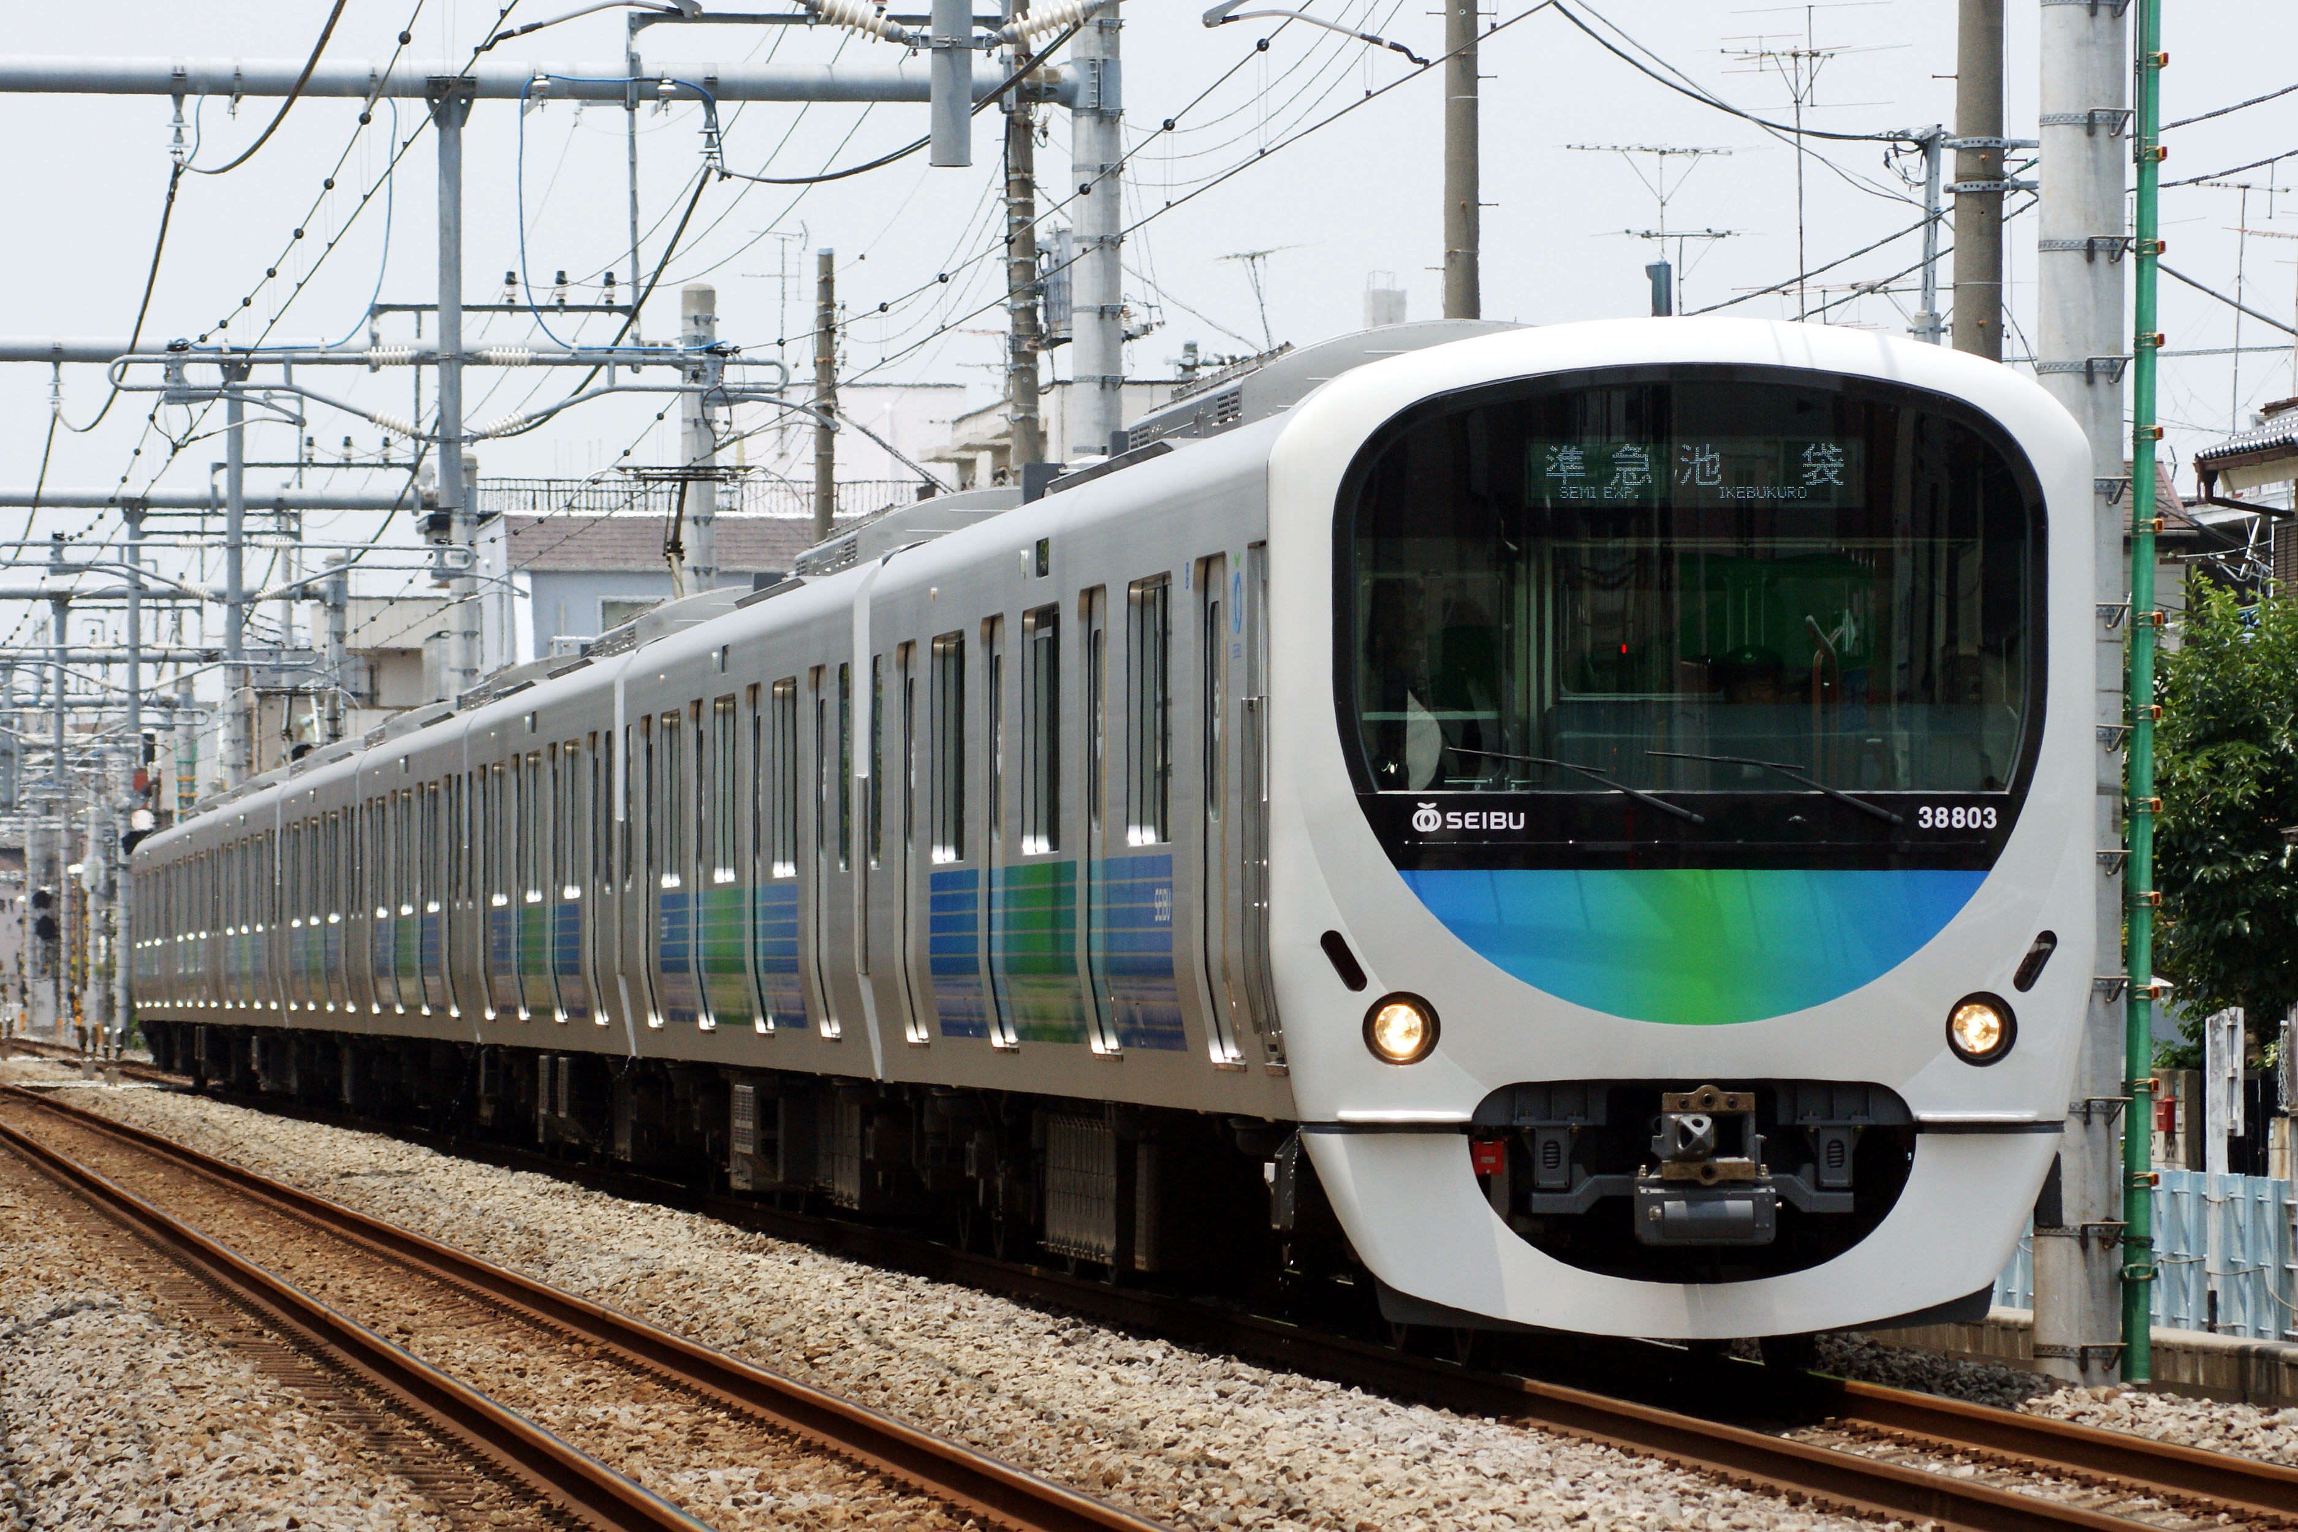
The challenge for the built environment sector in the UK
The Government is committed to a trajectory for reducing UK CO2 emissions (baseline 1990 emissions) based on Climate Change Committee recommendations:
68 per cent in 2030
78 per cent in 2035
Net Zero Carbon by 2050
The Climate Change Committee has identified the key shifts required.
Low carbon residential heating
Reducing energy consumption by buildings
Decarbonisation of industry – e.g. hydrogen
Significant reductions in vehicle emissions

Slide 4
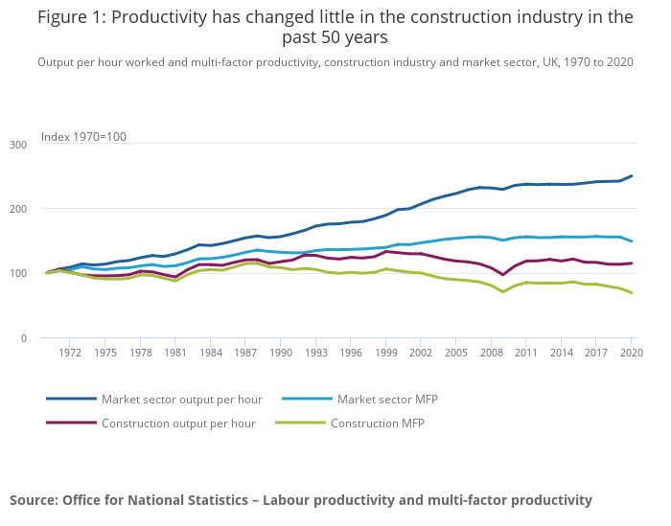
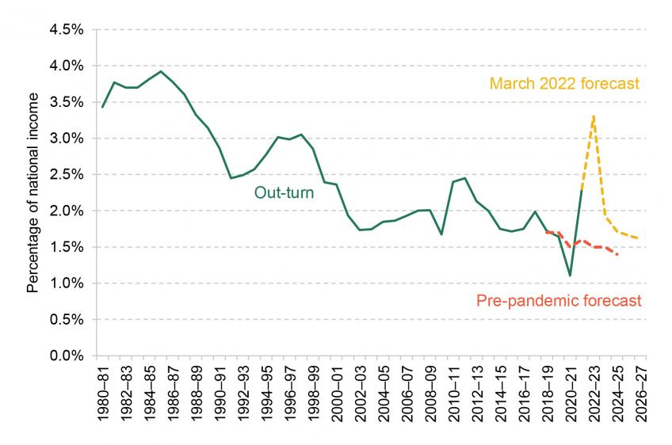
Governments around the world face the challenge of delivering new and retrofitted buildings and infrastructure whilst under huge fiscal pressure
Construction Productivity improvement has been below that of the rest of the economy for 50 years
UK Government Debt Interest Repayments (Institute of Fiscal Studies 2023)

Slide 5
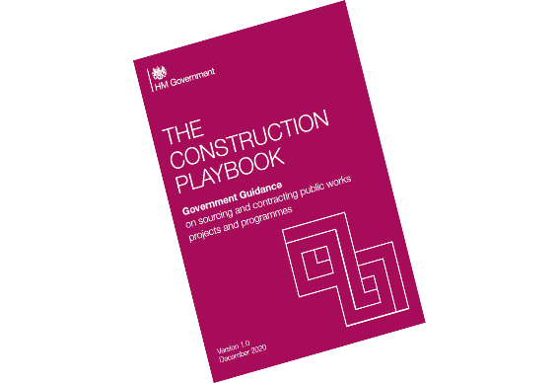
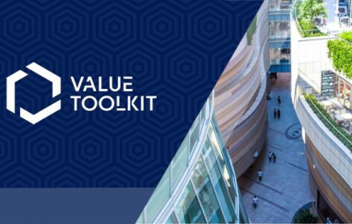


The UK Government has put in place a policy framework to guide construction procurement to drive modernisation of the industry
Productivity
Design: BIM, Rapid Engineering Modelling, object libraries and configurators
Industrialisation: manufacturing built assets, automation, robotisation
Connected and Autonomous Plant: connecting assets and the supply chain
Skills: building digital capability
Improved Operations
Supply chain integration: improved logistics and integration with onsite operations, payment and contractual management
Asset optimisation: interconnected systems, data sharing
Culture Change
Collaboration: improved transparency and information flows within supply chains
Quality: Value based procurement, management systems and defect prevention
Safety: Golden Thread of building safety information, improved site environments, occupational and mental health

Slide 6
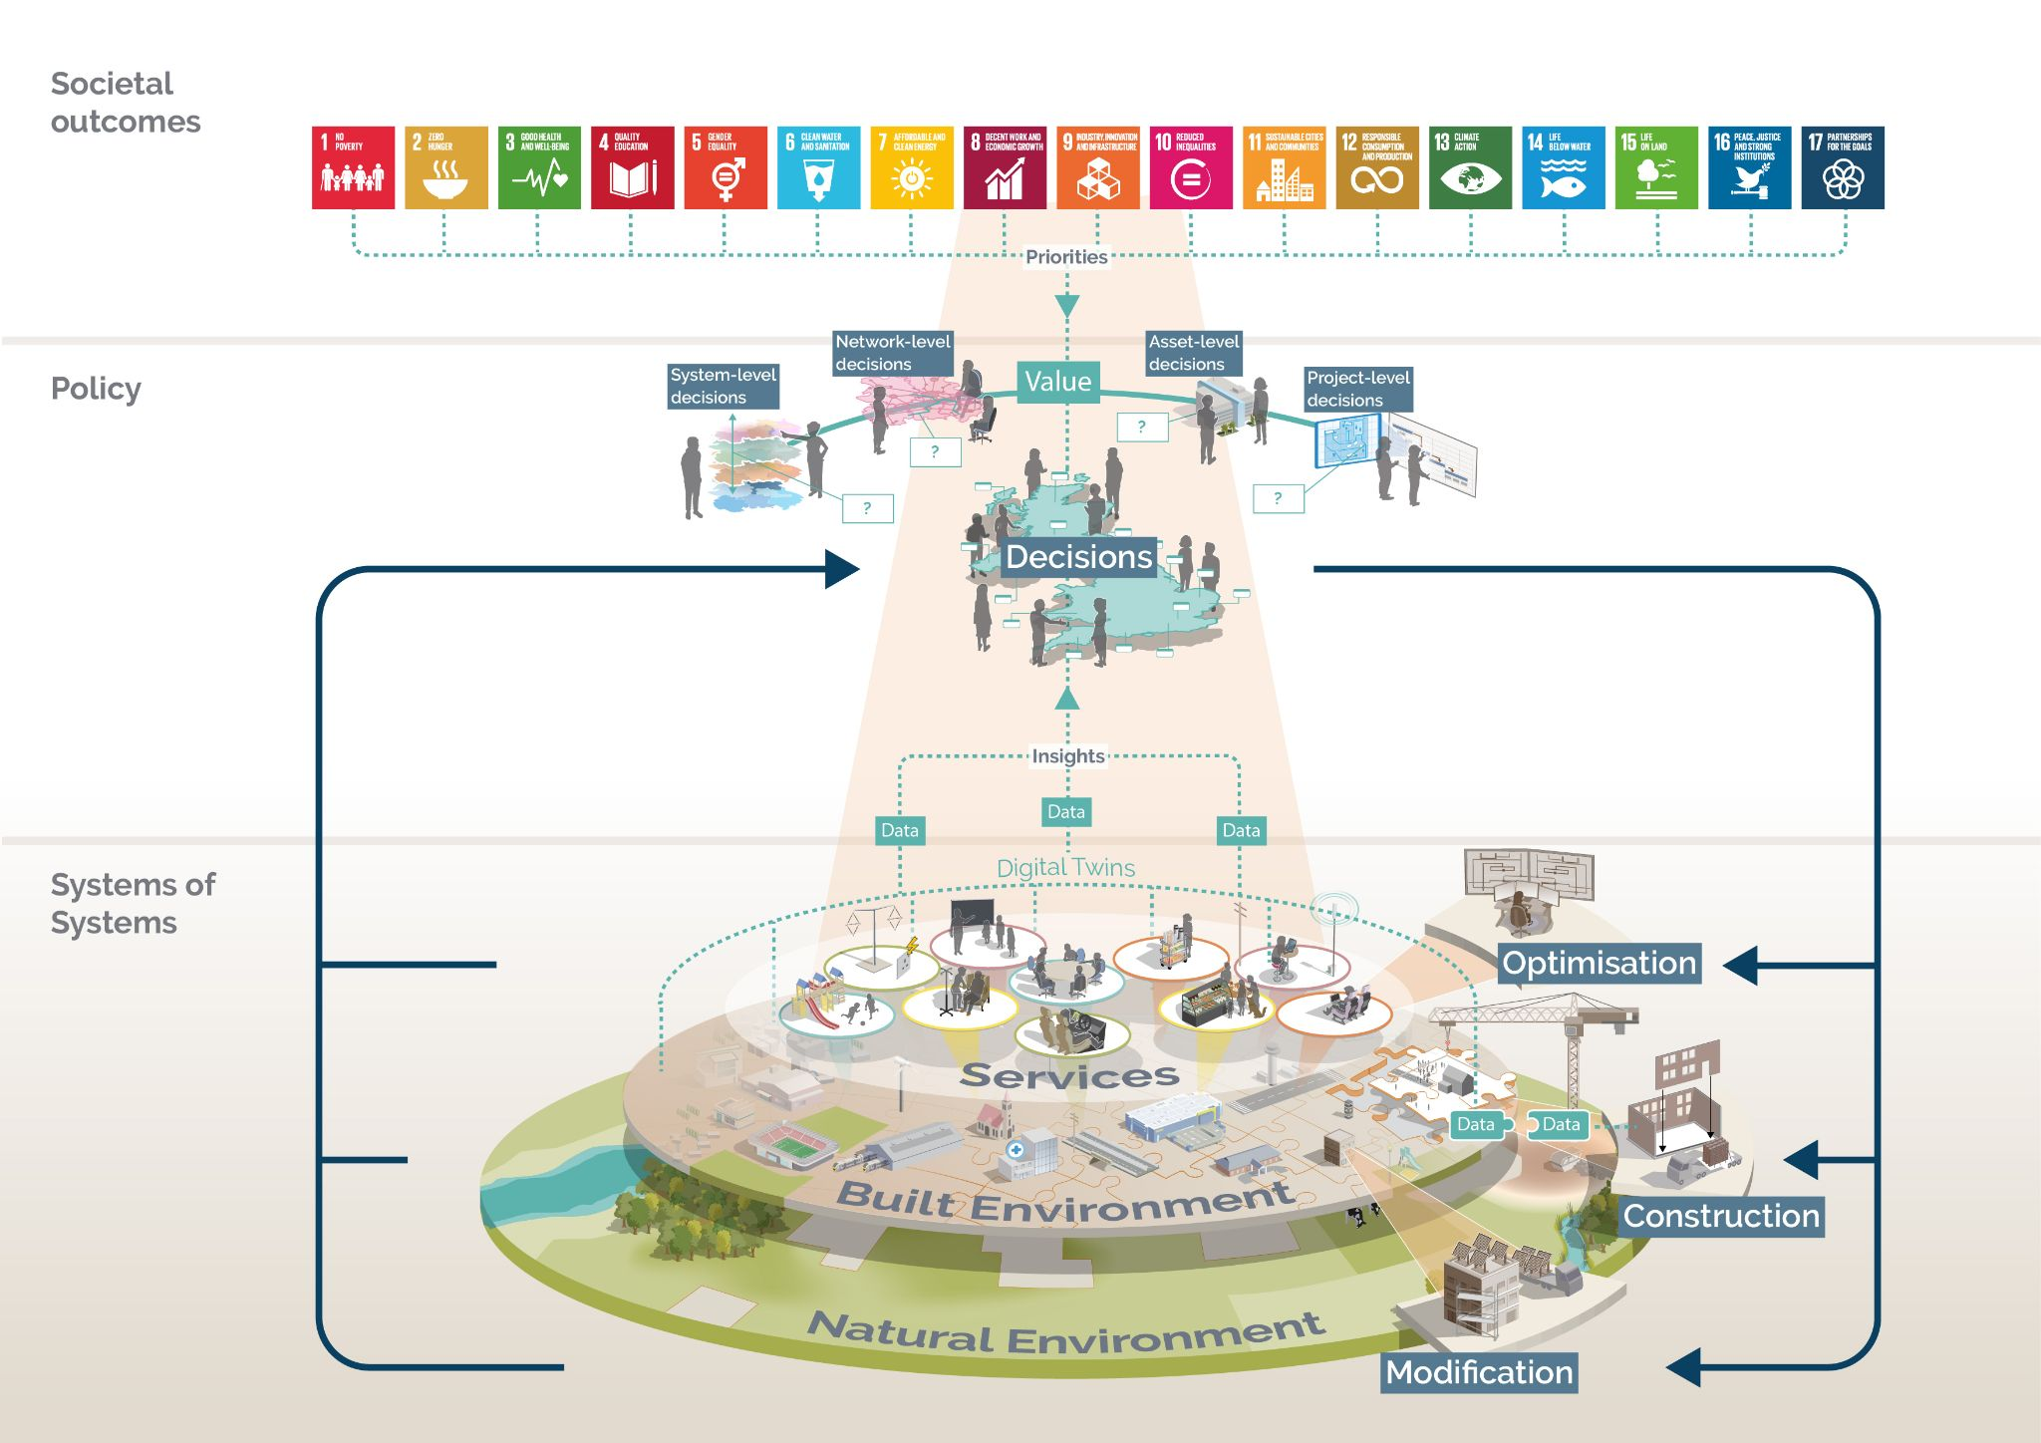
This will help to deliver the Vision for the Built Environment: managing this as a complex system of systems

Slide 7
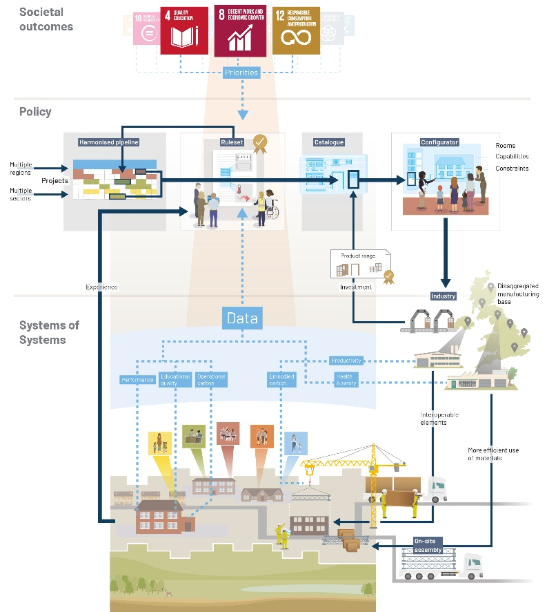
Transforming the supply chain
“Building on the presumption in favour of offsite construction, we are committed to creating a dynamic market for innovative technologies in the UK…There is a new expectation for departments and ALBs to set targets for the level of use of MMC in the delivery of projects and programmes.”
Construction Playbook (Dec 2020)
“This pipeline outlines the extent to which new work will incorporate delivery through MMC. 170 of the contracts in procurements, totalling an estimated capital value ranging between £15.4 billion and £22.4 billion, are planned to include elements delivered by making best use of MMC.”
Analysis of the National Infrastructure and Construction Pipeline (Aug 2021)

Slide 8
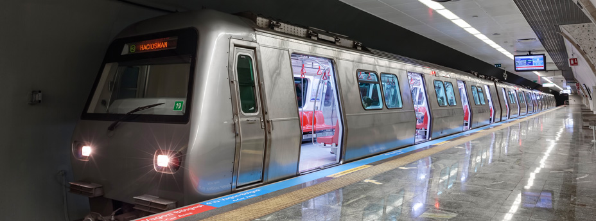
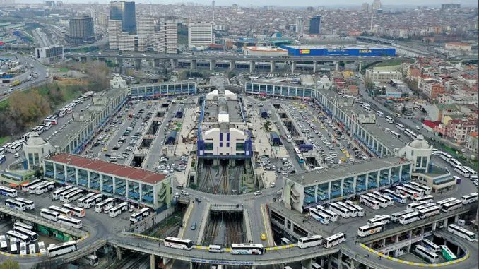
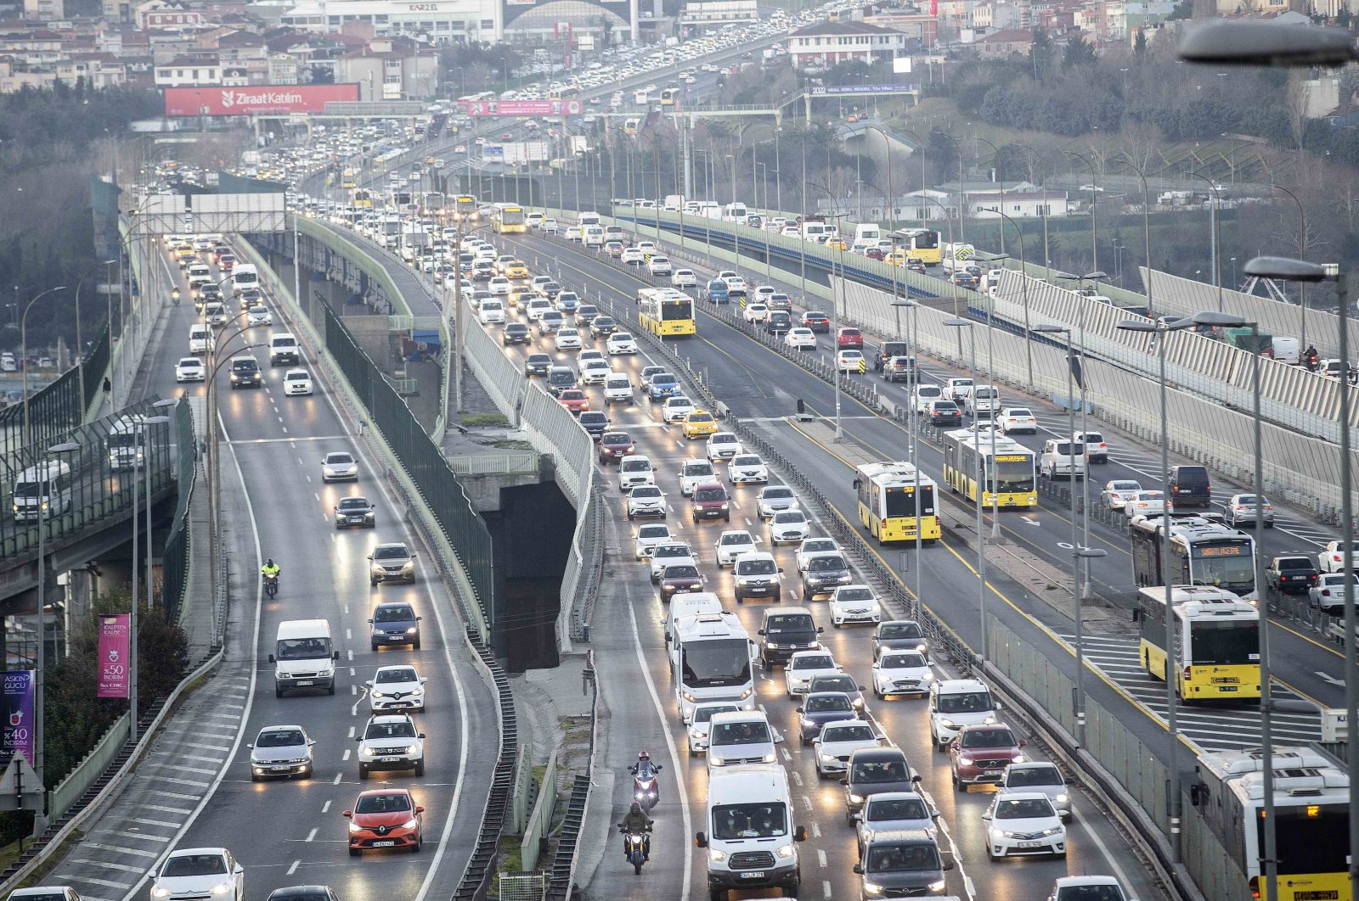
The Istanbul Sustainable Urban Mobility Plan is an example of inclusive, sustainable and outcome-focused infrastructure planning
4 cross-cutting sub-themes informed the development of the SUMP
Safety
GESI
Theme 1: Transition to Low carbon
Low emission zones
Decarbonised public transport
Improved provision for cyclists and pedestrians
Theme 2: Seamless Transfer and Integration
Transport system control centre
Improved information for passengers
Theme 3: Reducing Congestion
Congestion charging
Improved parking enforcement
Construction logistics centres
Resilience
Innovation

Slide 9
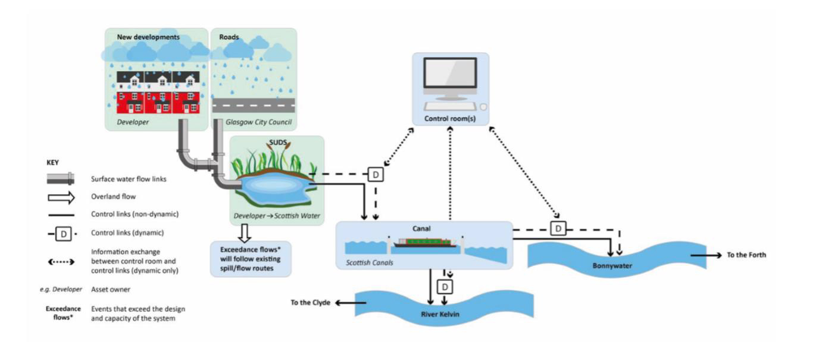
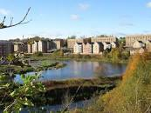
Smart infrastructure assets are already in operation, and delivering benefits. The next step is to connect these and enable information exchange across assets and systems.
Glasgow Smart Canal – Smart System delivering Climate Resilience

Slide 10
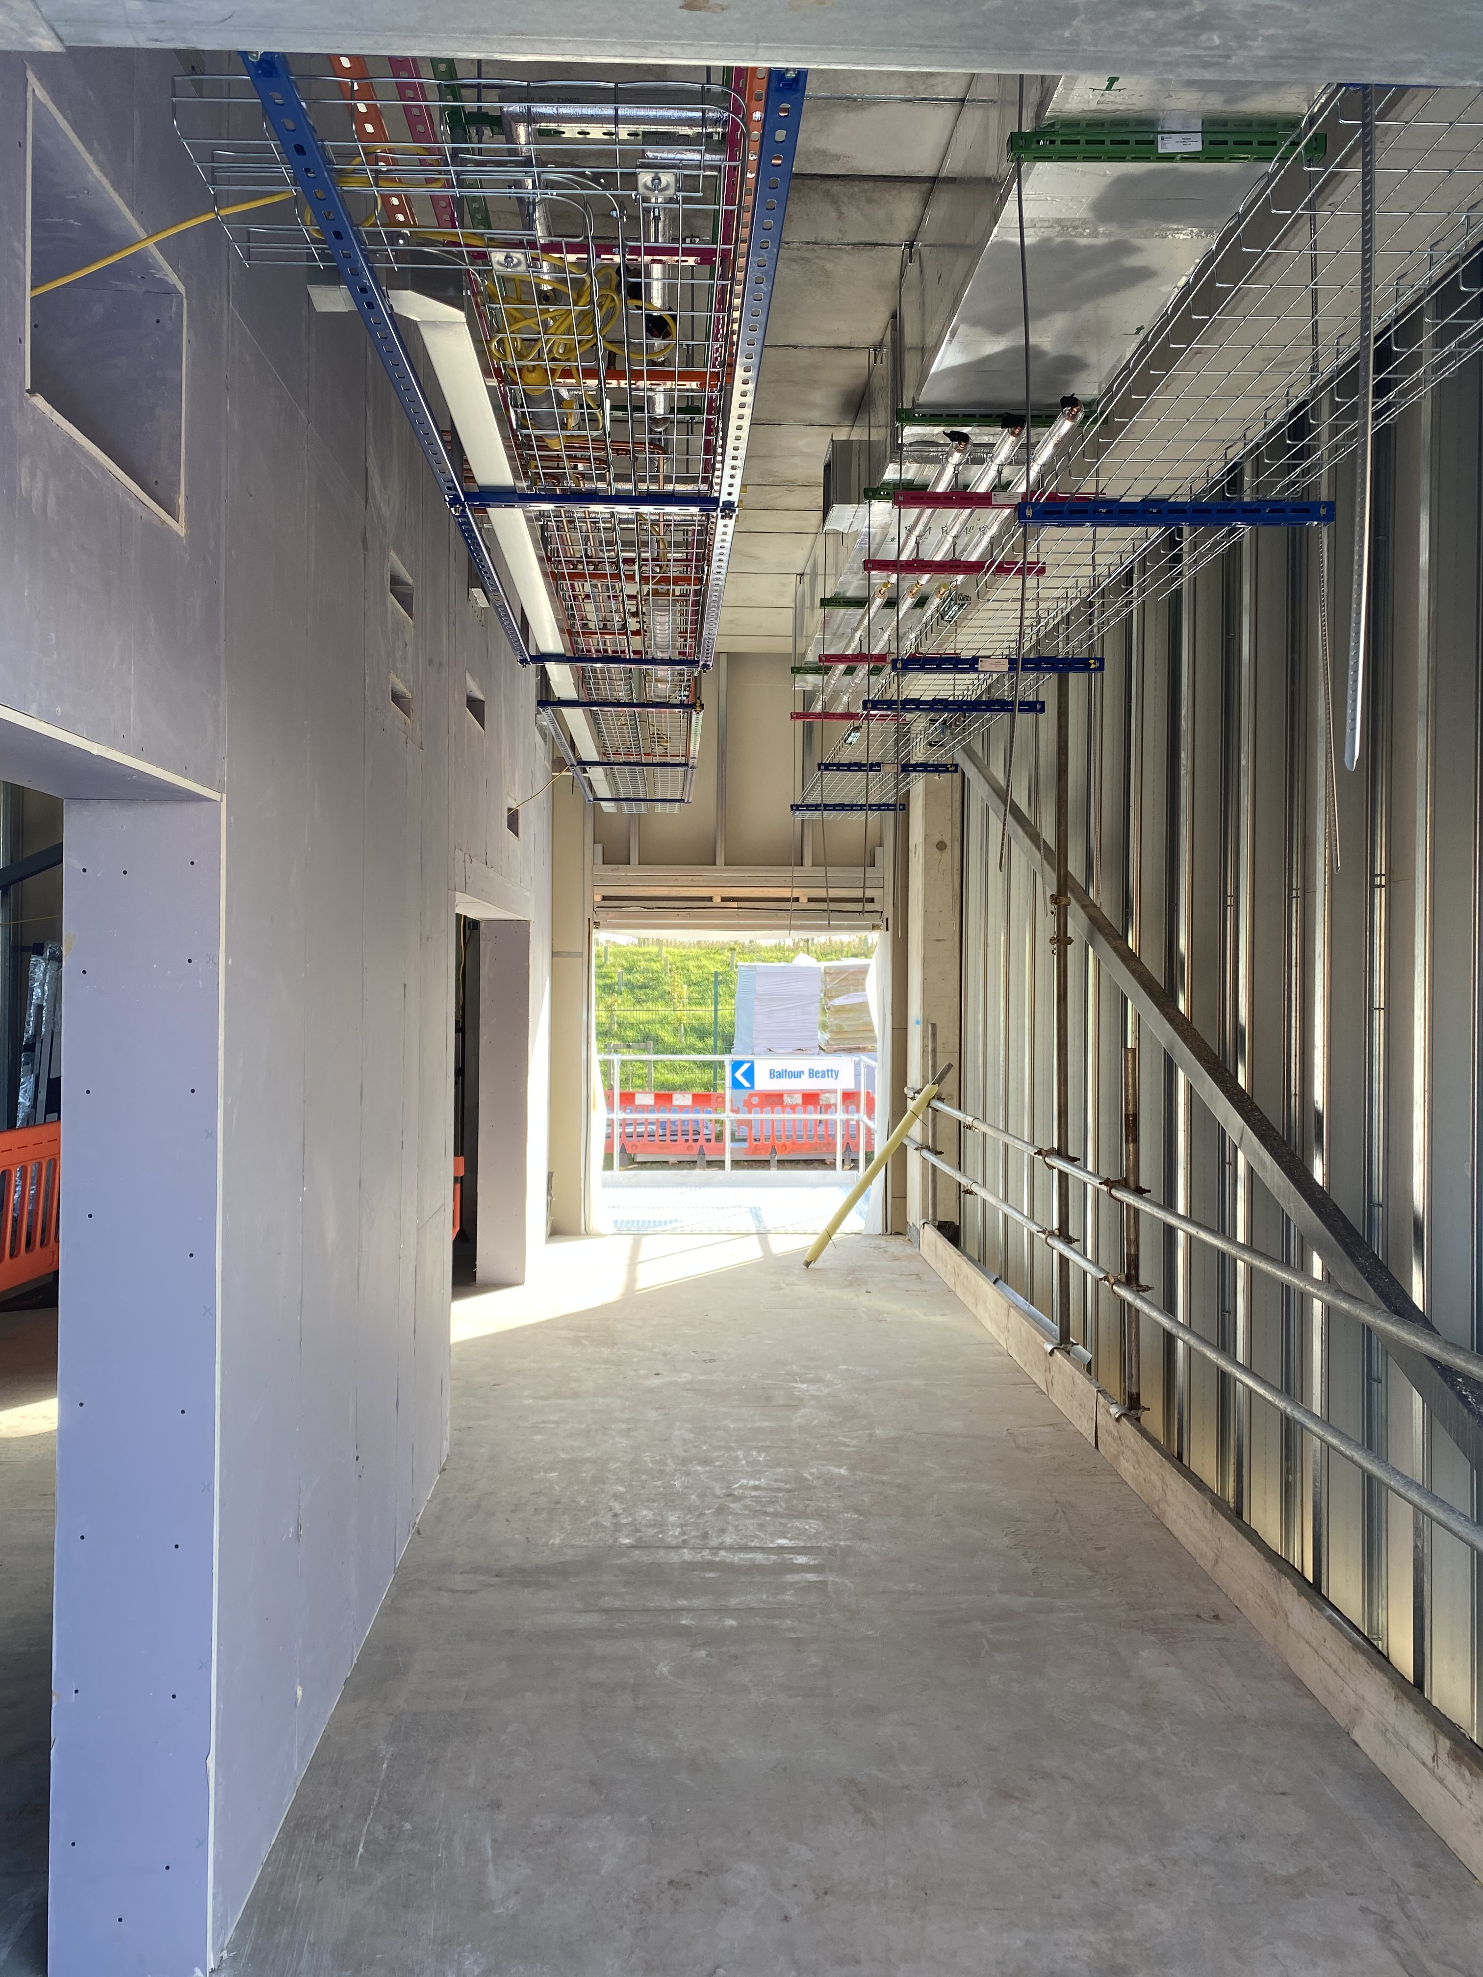
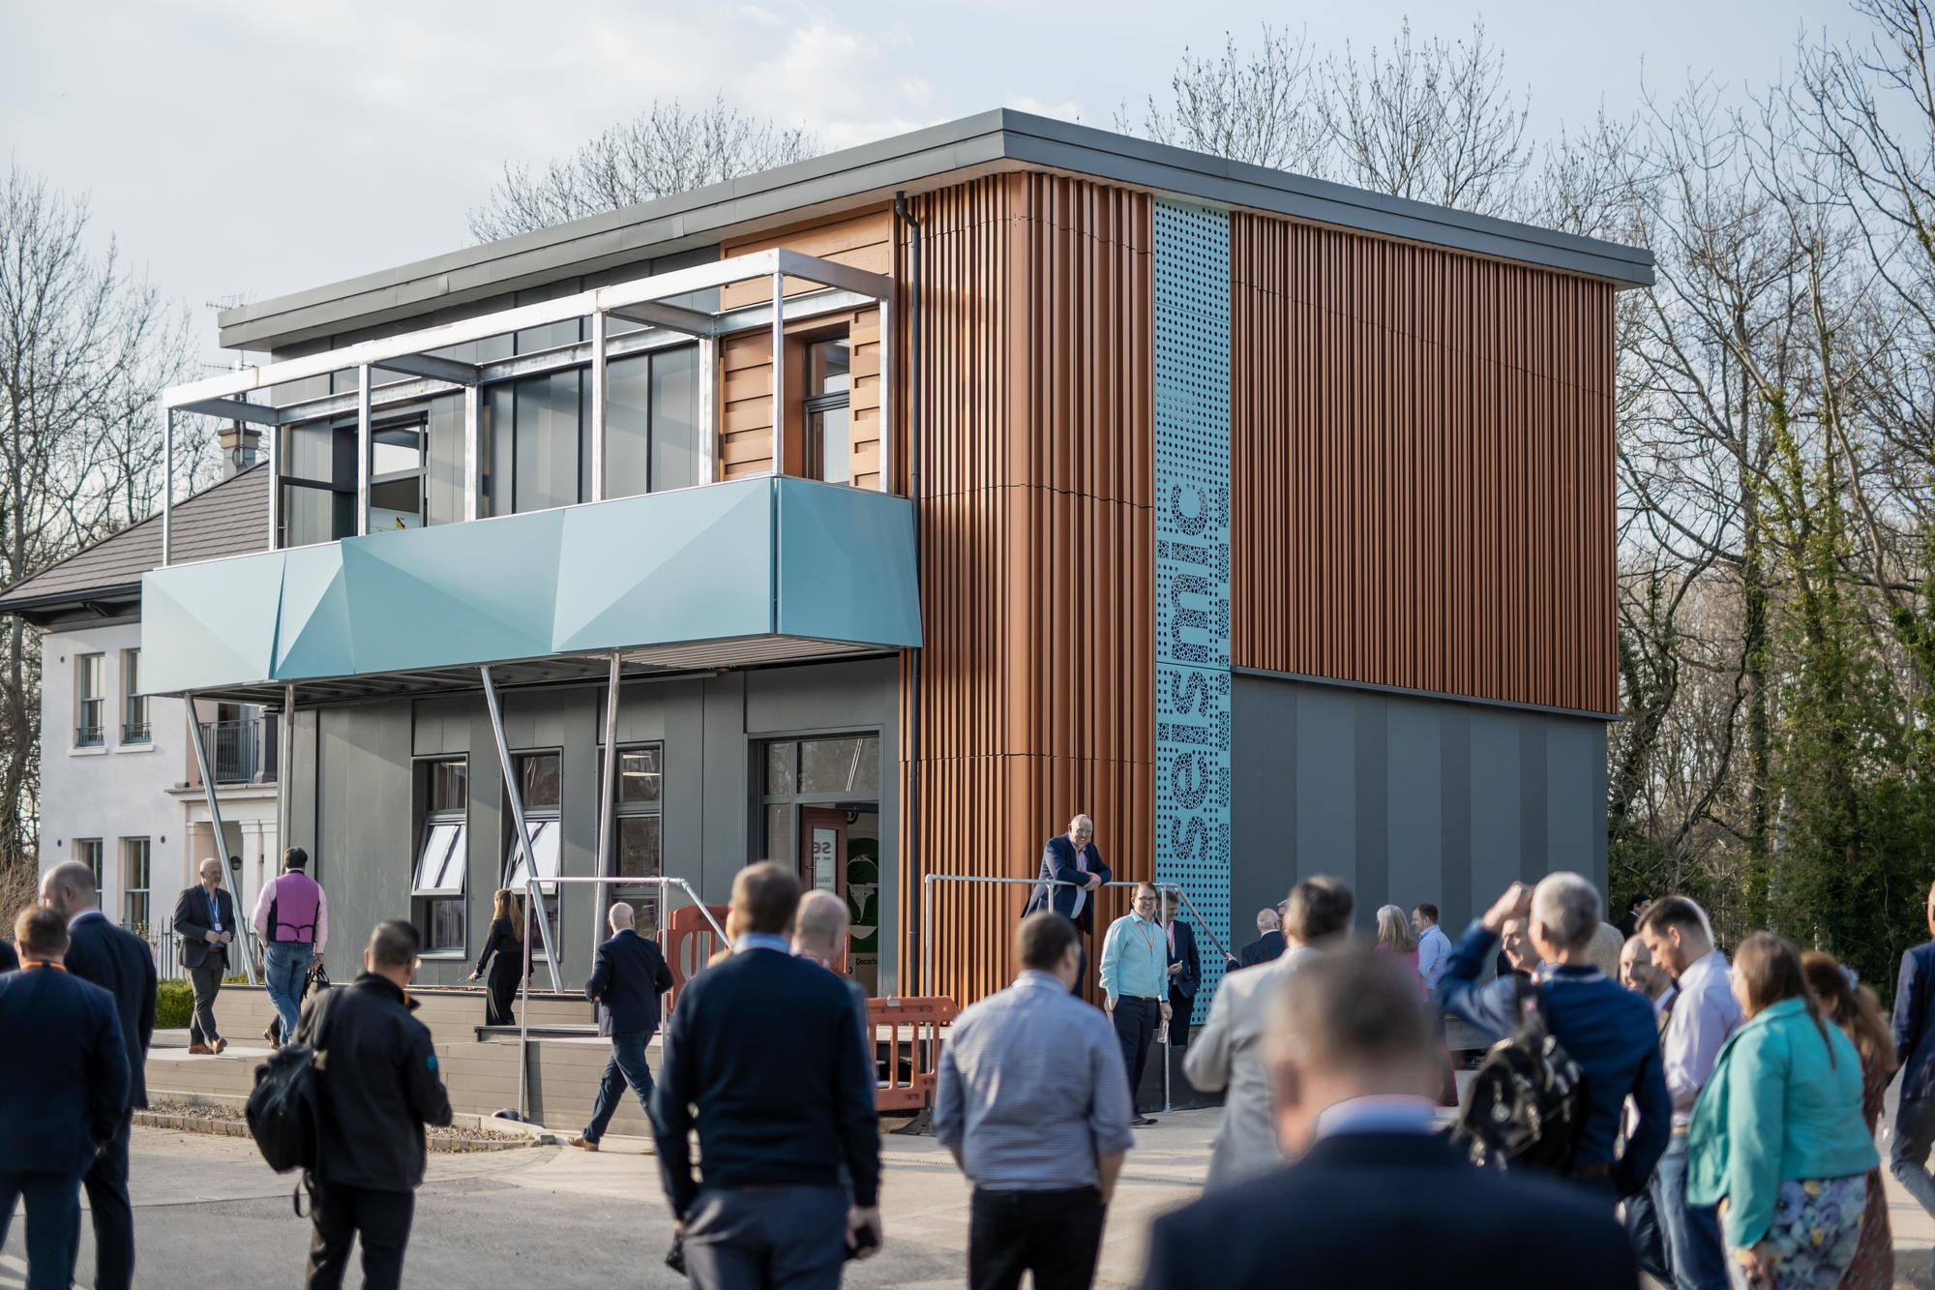
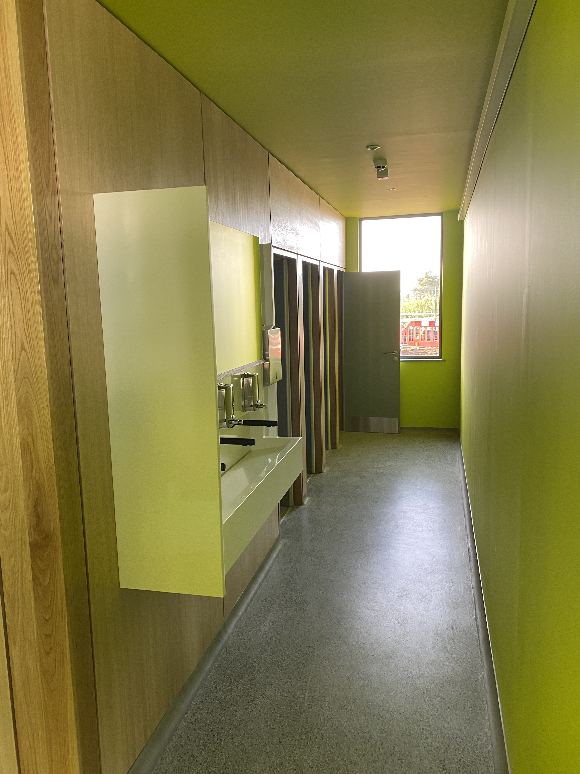
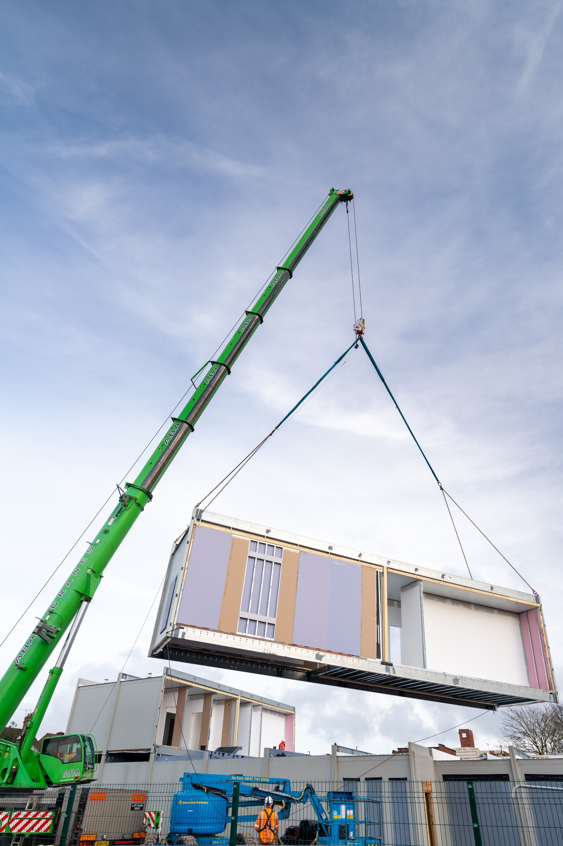
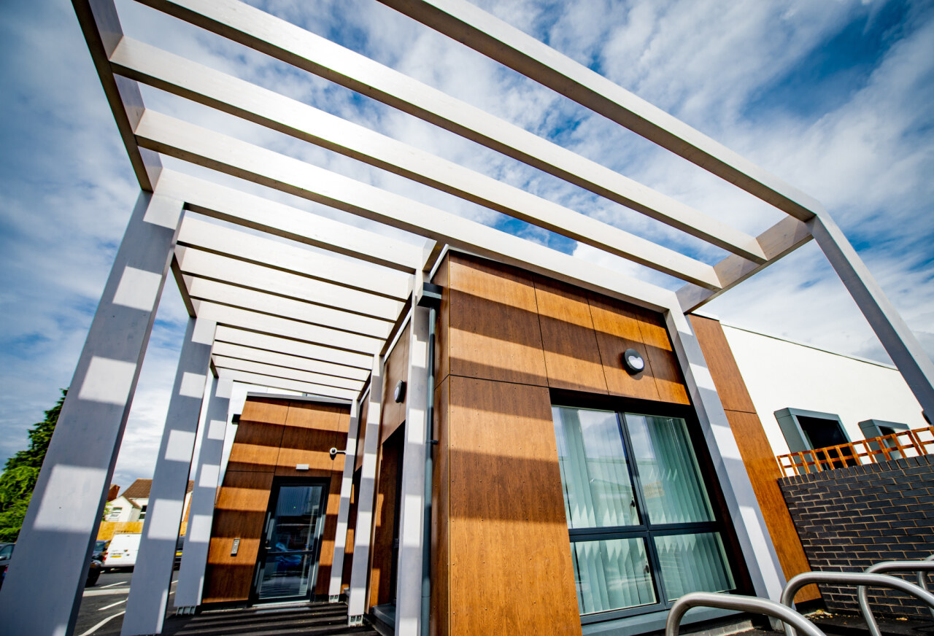
Platform and modular solutions are transforming the speed of delivery, asset performance and sustainability of government construction projects
SEISMIC Product Platform
Uses standardised, precision-manufactured components.
75% quicker to deliver than traditional onsite construction.
A 70% saving in whole life carbon emissions, through reduced waste, and improved heat and energy performance.
90% of the building can be reused or recycled.
Now delivering £19.2m Laurence Calvert Academy.
Foleshill Community Healthcare Centre
Designed to achieve outstanding environmental performance from the outset, based on a whole life carbon approach.
Manufactured offsite and assembled onsite, taking advantage of a known performance platform, cost £3m.
Reduced duration of onsite activity by 13 weeks.
Certified as achieving the Passivhaus standard in 2021. Consumes less that 20% of the energy of a typical NHS clinic, saving an estimated 411 tonnes of CO₂ pa.

Slide 11
Summary: What steps are needed to decarbonise construction?
A whole-life approach to asset management is an essential success criterion. Significant reductions in carbon emissions can be achieved within existing project budgets, or with limited additional capital expenditure – with benefits realised through savings when in operation.
Carbon is an effective lens to drive improvements in productivity and efficiency at all stages of the asset lifecycle, from design through delivery to operation. R&D focused on one delivers benefits in relation to the other.
A clear policy framework is required to deliver decarbonisation – but this is insufficient unless it influences operations – planning, procurement, contract terms, the delivery model and asset management.

Slide 12
Slide title

