Slide 1
Your Complete Building Control Service.
Preston. Manchester. Birmingham. London. Leeds

Slide 2
Building Safety Act Gateway 1
Richard Cymler Regional Director Ball & Berry Approved Inspectors

Slide 3
Gateway 1
Grenfell Tower Fire 14.06.2017
Building Safety Act 2022 Royal Ascent 28.04.2022 to include Gateway 2 & 3.
Gateway 1 introduced 01.08.2021 via Town & Country (Development Management etc) Order 2021.
HSE Statutory Consultee for relevant buildings.

Slide 4
Relevant Buildings
Contains two or more dwellings or educational accommodation (residential)
18m+ in height or seven or more storeys
A mezzanine is a storey if its floor area is at least 50% of the floor area of largest storey above ground
Basements/plant rooms excluded

Slide 5
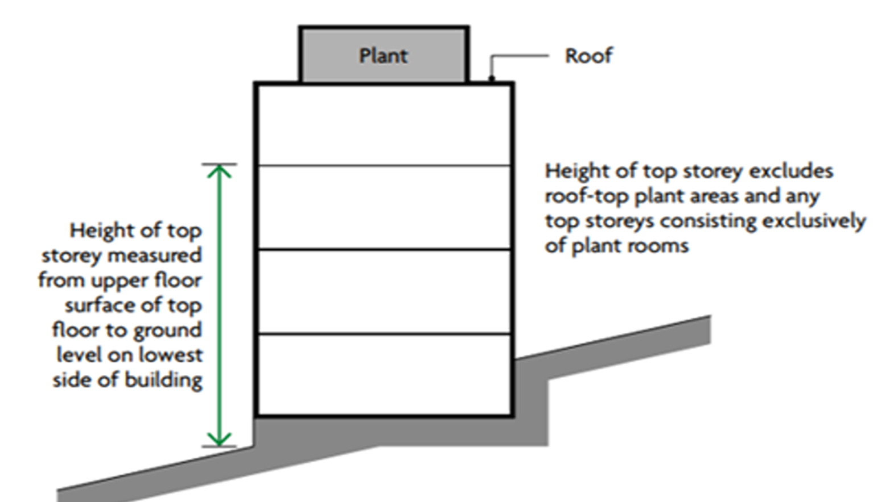

Slide 6
Gateway 1 Applications
Provision of one or more relevant buildings.
Development of an existing relevant building (including Change of Use).
Development within the curtilage of a relevant building.
Outline Planning applications exempt.
Must be accompanied by a Fire Statement (form published by the Secretary of State).

Slide 7
Fire Statement
Prescribed form www.gov.uk 15 pages and associated guidance document also 15 pages.
Name of person completing including relevant qualifications & experience.
What, if any, consultation has taken place ?
How fire safety has been addressed & Building Design fire safety features.
Location including Fire service access/water supply etc

Slide 8
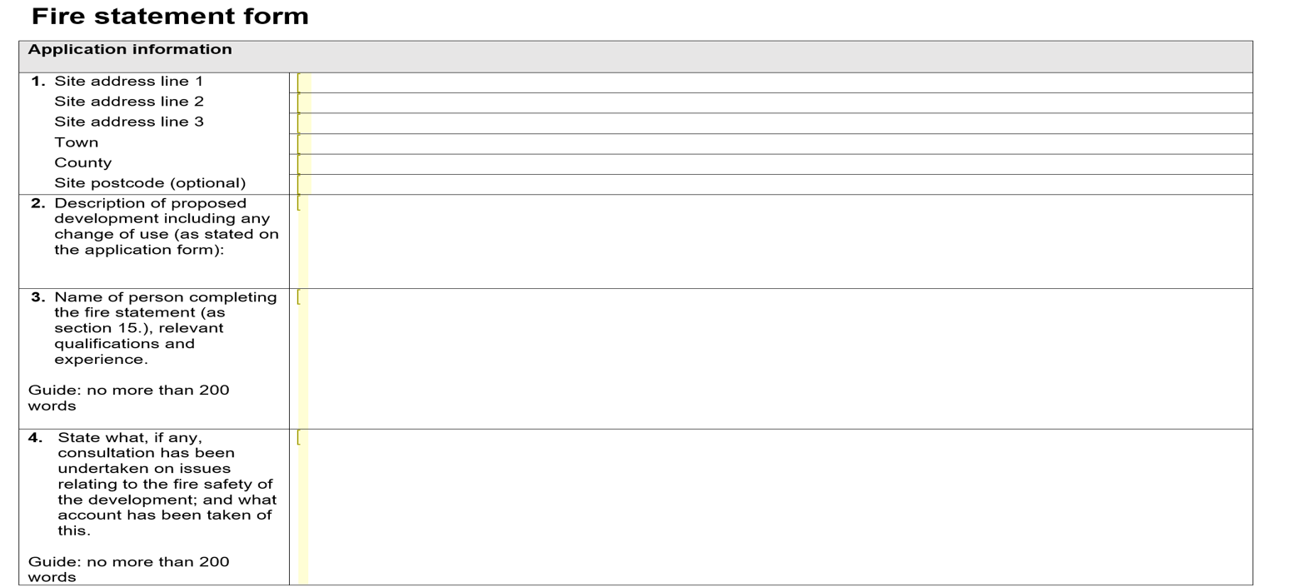

Slide 9
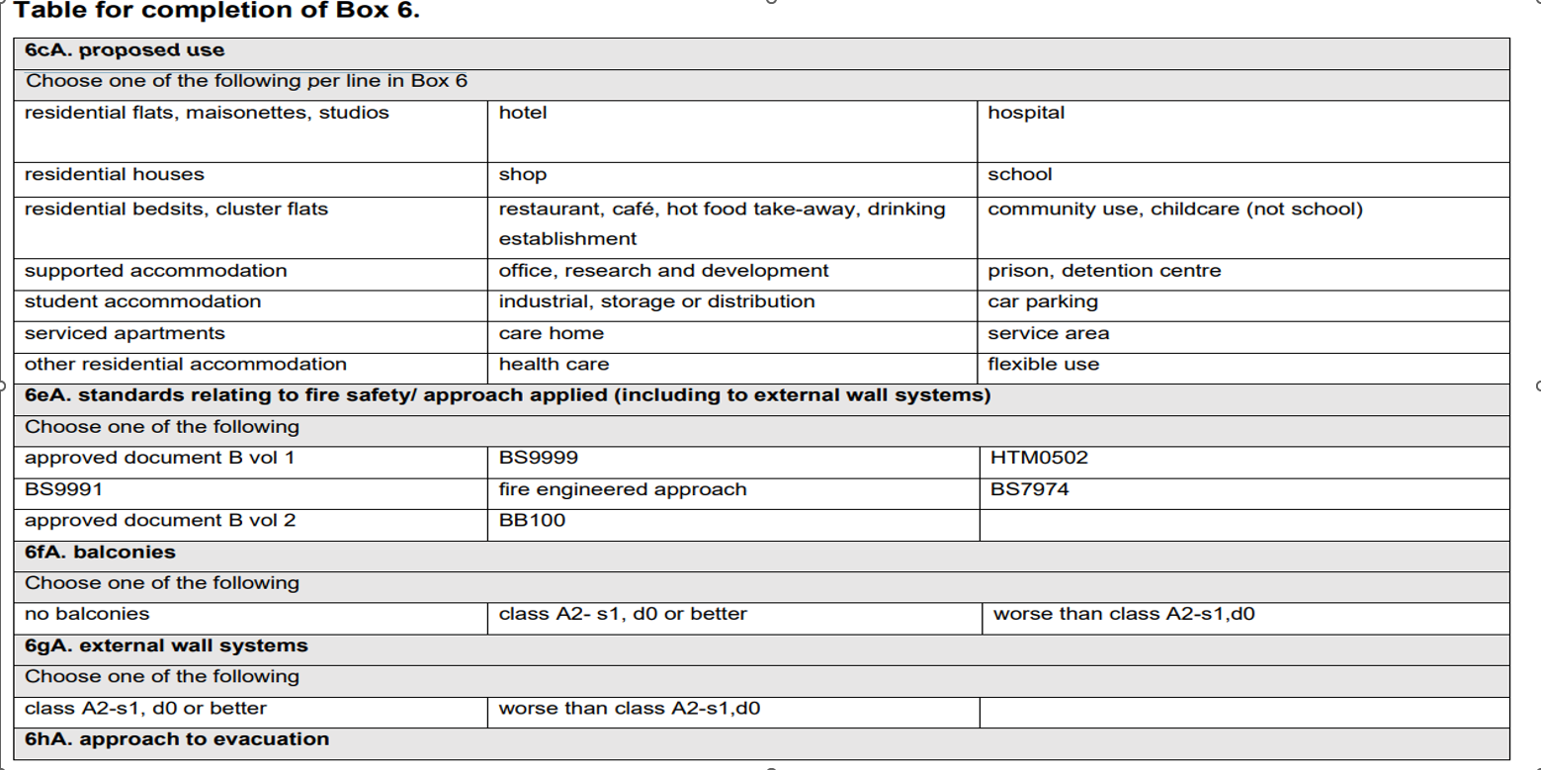

Slide 10
HSE building safety ebulletin

Slide 11
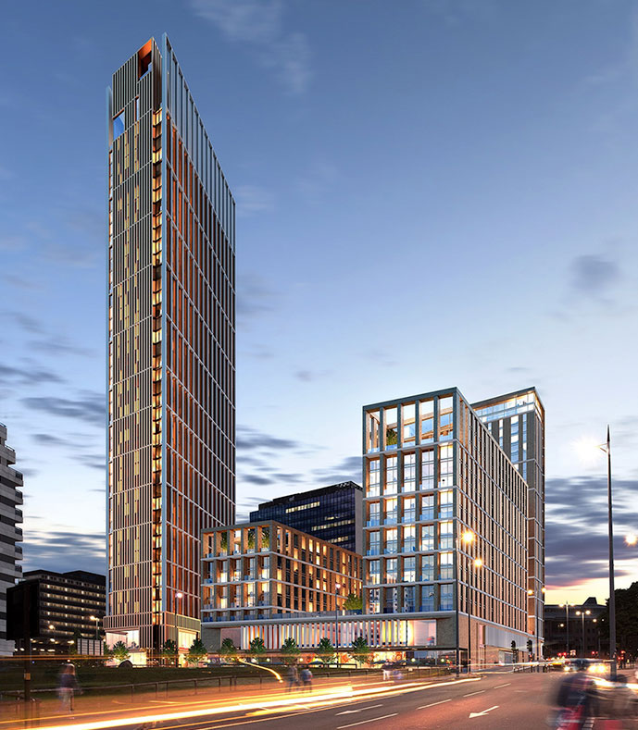
Gateway 2 eta October 2023
Do not pass Go !!
Secondary Legislation
Relevant buildings Gateway 2 – Hard Stop Full design approval from HSE prior to commencement. 12 weeks
Stop notices/Compliance Notices
2 years prison/unlimited fine
Gateway 3 – Final certificate /occupation certificate (October 2024 ?)
Existing buildings – as of April 2020 estimated 12,500 relevant buildings.

