Slide 2
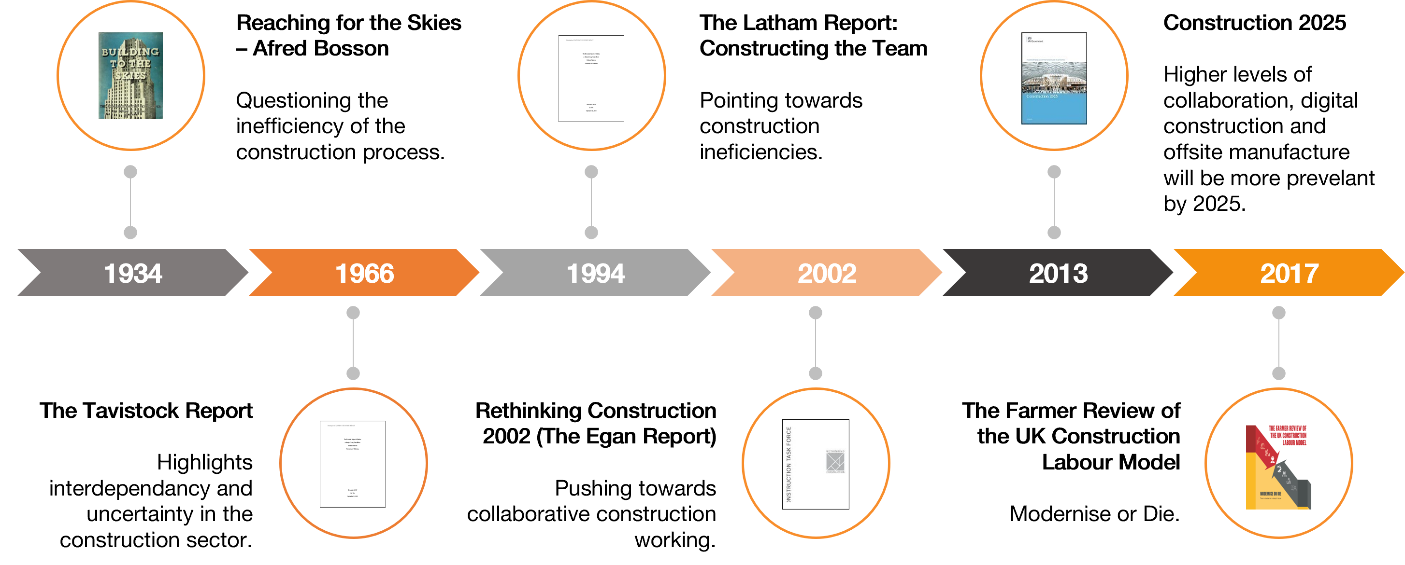
TIMELINE OF MOMENTUM……
HOW LONG HAVE WE BEEN WAITING

Slide 3
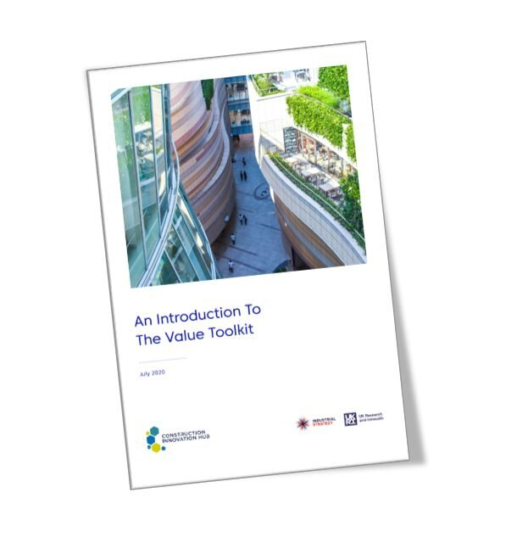
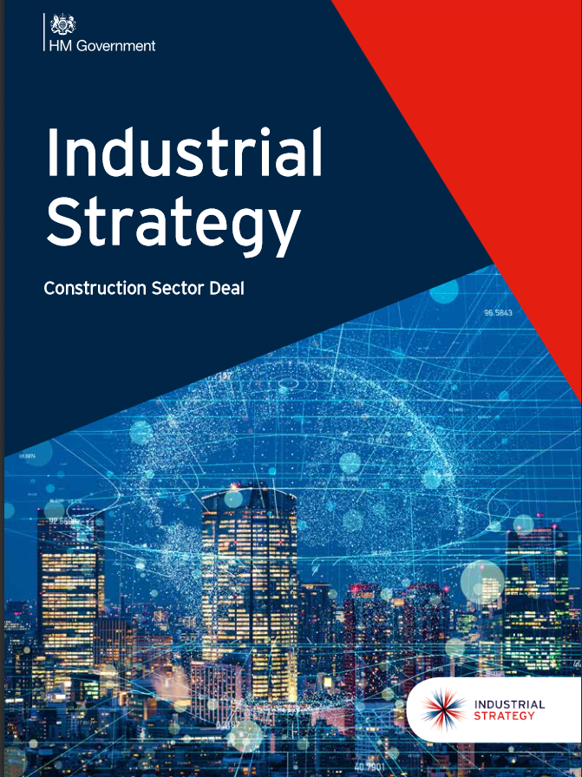
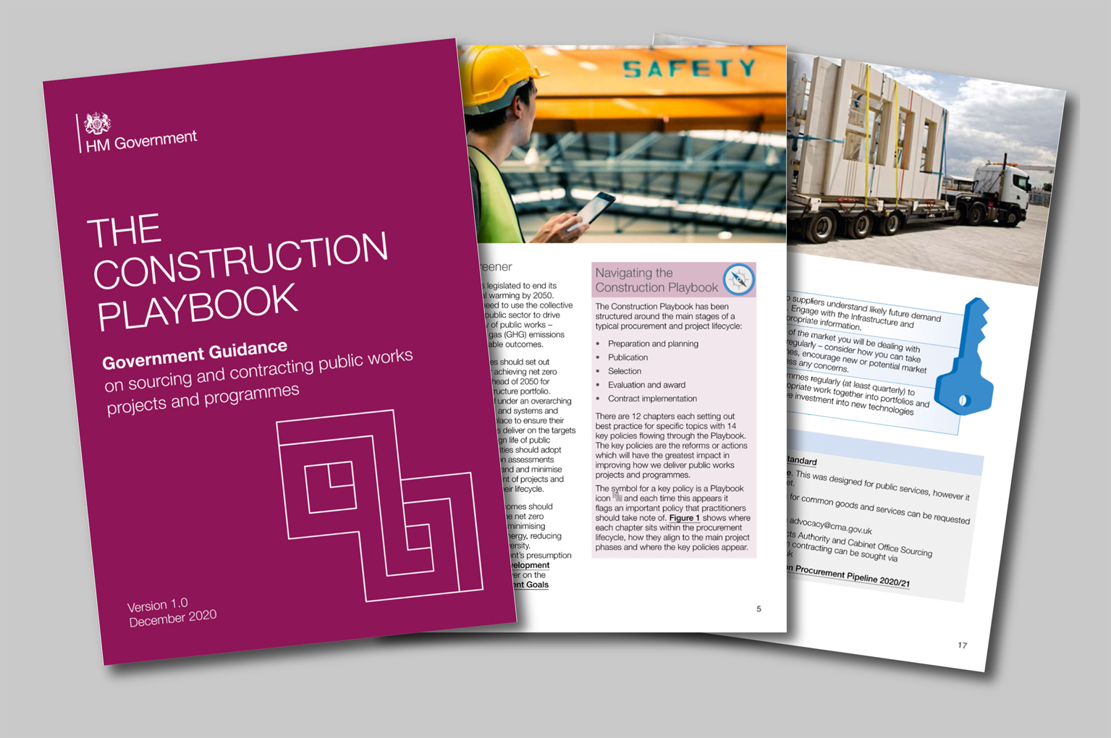
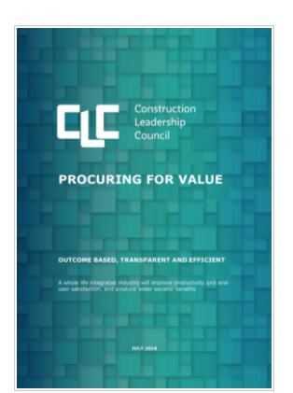
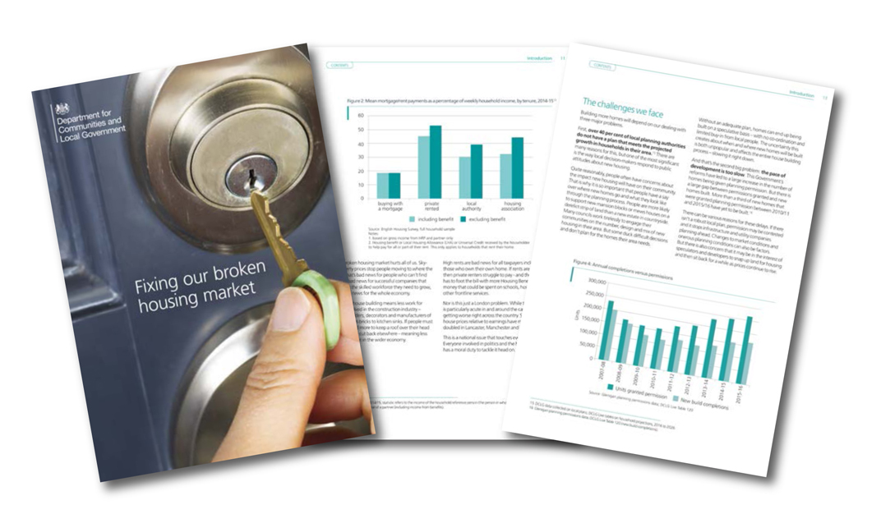
CHALLENGES FACING US ALL
HOW POLICY WILL DRIVE CHANGE

Slide 4
SMART CONSTRUCTION
Smart Construction is building design, construction and operation that through collaborative partnerships makes full use of digital technologies and industrialised manufacturing techniques to improve productivity, minimse whole life cycle cost, improve sustainability and maximise use benefits.

Slide 5
DESIGNING FOR MANUFACTURE AND ASSEMBLY
QUITE SIMPLY
DfMA is all about how we can design a product to be consumed by the manufacturing process as quickly and with as little waste as possible.

Slide 6
3D MODELLING AND BIM
Notes:
The benefits of designing first means that all of your construction project can be modelled in 3D both architecturally and from a manufacturing perspective.
The advantages of a BIM approach for a construction or engineering company consist of a more efficient process of management and control.
Through integrated BIM 3D modelling, the details of the measurements are taken directly from the designer’s data; so in the event that a designer makes some alterations, the estimate can be updated automatically.
Furthermore, work scheduling can be carried out with greater awareness of the constructive dynamics involved, by comparing the work status to the estimated completion times; and for each single activity and constructive element of the work, in order to finish the construction job.
By creating a virtual asset, we can add associated costs and produce detailed BoM’s. It is possible to avoid delay and rework on site allowing tighter control over costs.
At modularize our models are linked to a mass of data to improve the accuracy and quality of the information we produce while reducing the time needed to deliver that information to clients.
The data is stored in a product data management system. This allows us to identify every part of every building and its specific location. From a facilities management point of view we can attach data sheets and specifications to ensure the correct replacement or maintenance of products are used during the lifecycle of the building.

Slide 7
PRODUCT DATA MANAGEMENT
PRODUCT LIFE CYCLE MANAGMENT
PDM
PLM
PLM not only manages all product related data, but also extends the benefits of PDM to support the whole business across the product lifecycle, of the manufacture, construction and in use life
PDM takes control of designs, documents, BoM’s and processes, primarily to drive efficiency and productivity, but also to improve collaboration across the business.

Slide 8
WHAT DOES THE FUTURE LOOK LIKE?
“A DIGITAL TWIN (DT) - - is a digital representation of a physical asset. Linked to each other, the physical and digital twin REGULARLY EXCHANGE DATA throughout the product lifecycle and use phase. Technology like AI, machine learning, SENSORS and IOT allow for dynamic data gathering and right-time data exchange to take place”

Slide 9
THANK YOU FOR LISTENING
GAYNOR.TENNANT@OFFSITEALLIANCE.ORG

